Slide 1



Extracting Knowledge from Informal Text
Alan Ritter
ZZZZZZZZZZZZZZZZZZZZZZZZZZZZZZZZZZZZZZZZZZZZZZZZZZZZZZZZZZZZZZZZZZZZZZZZ ZZZZZZZZZZZZZZZZZZZZZZZZZZZZZZZZZZZZZZZZZZZZZZZZZZZZZZZZZZZZZZZZZZZZZZZZ ZZZZZZZZZZZZZZZZZZZZZZZZZZZZZZZZZZZZZZZZZZZZZZZZZZZZZZZZZZZZZZZZZZZZZZZZ ZZZZZZZZZZZZZZZZZZZZZZZZZZZZZZZZZZZZZZZZZZZZZZZZZZZZZZZZZZZZZZZZZZZZZZZZ ZZZZZZZZZZZZZZZZZZZZZZZZZZZZZZZZZZZZZZZZZZZZZZZZZZZZZZZZZZZZZZZZZZZZZZZZ ZZZZZZZZZZZZZZZZZZZZZZZZZZZZZZZZZZZZZZZZZZZZZZZZZZZZZZZZZZZZZZZZZZZZZZZZ ZZZZZZZZZZZZZZZZZZZZZZZZZZZZZZZZZZZZZZZZZZZZZZZZZZZZZZZZZZZZZZZZZZZZZZZZ ZZZZZZZZZZZZZZZZZZZZZZZZZZZZZZZZZZZZZZZZZZZZZZZZZZZZZZZZZZZZZZZZZZZZZZZZ ZZZZZZZZZZZZZZZZZZZZZZZZZZZZZZZZZZZZZZZZZZZZZZZZZZZZZZZZZZZZZZZZZZZZZZZZ ZZZZZZZOOOOOOOOOOOOOOOOOOOOOZZZZZOOOOOOOZZZZZOOOOOOOOOOOOOOOOOZZZZZZZZZZ ZZOZZOOZ..................:8OOZZO~....,.$OOOZOI,............:ZOOZZZZZZZZ OZOZZOOZ...................NZOZON,......?8ZZZO$..............8OZZZZZZZZZ OZOOZOO$..................,MZZZO+.......,DOZOO7..............8OOOZZZZZZZ OZOOZOO$...................MZOOD:...,....OO$O87..............DOZOZZZZZZZ ZOOOZOOZ=++~,........,~++=+DOZO7......,..~8OZZZ=++=,....,++++8OZOZZZZZZZ ZZZZZZZZOO88?...... .=N88OOOZ8,. ........OZOZZOO8$.....$D8O8ZOOZZZZZZZZ ZZZZZZZZZZOOZ..... ..,NOOZZOZZ.. . ....I8OZZZZ8=.....88ZZOZZOZZZZZZZZ ZZZZZZZZOZOO8:... .....IOZOOZ8~.. ......DZOZOOO.....+DZOZZOZZZZZZZZZZ ZZOOOOZZZZZOO?... ... .~8OZOO8,............ZOOZOOI.....Z8OOZZOZOZZZZZZZZ OOOOOOZZZZZOOD..........ZOOZ8+.............~DZOZD,....,MOOZZOOZOOZZZZZZZ OOOOZZZZZZOOZD~.........7O8OD:.............,8OZOO.....?DOZZZZZOOOZZZZZZZ OOZZZZZZOZZOOO7..... ...,DOO$.... ,.........?8O8:....,N8OZZZZZOOOZZZZZZZ OOZZZZZZOOZOOOO..........OO8?.....I ........~DOO.....~NOOZZZZZOOOZZZZZZZ OZZZZZZZZOZOOZ8+.........=DO.....=M,.........O8?.....O8OOZZZZZOOZZZZZZZZ ZZZZZZZZZOOZZOZ8....... ..N=.....8D?....... .=N.....~NOOZZZZZZOOZZZZZZZZ ZZZZZZZZOOOZZOO8:.........$.....,NO8.. ......,I.....I8OZZZZZZZOOZZZZZZZZ ZZZZZZZZZZOZZZOO$.. .... .......ZOOD:.. ..... , ...:NOZOZZZZZOZZZZZZZZZZ ZZZZZZZZZZZZZZZO8............. .DOO8+........ ....=NOOZZZZOOOZZZZZZZZZZ ZZZZZZZZZZZZZZZZ8+.. .... .....?8OZOD,........ ...DOOZZZZOOOOZZZZZZZZZZ ZZZZZZZZOZZZZOZZO$.. ..........Z8OOOD~....... . ..~NOOZZZZOOOOZZZZZZZZZZ ZZZZZZZZZZZZZZZOO8:...........~N8ZZOOZ............OOZOZ8ZZZZZOOOZZZZZZZZ ZZZZZZZZZZZZZZZOOOZ...........8OZOZOO8+..........=NOZZOOZZZZZOOOZZZZZZZZ ZZZZZZZZZZZZZZZZOO8..........,D8OOZOOO?..........+D8OZOOZZZZZOOOZZZZZZZZ ZZZZZZZZZZZZZZZZO8O8NNMNNMNNN88OZZOOOO8ONNNNNNNNDDOZZZOZZZZZZOOOZZZZZZZZ ZZZZZZZZZZZZZZZZZZ$O8O8O88OO8OOOZZOOZZO8OOOOOOOO8OZOOOZZZZZZZOOOZZZZZZZZ ZZZZZZZZZZZZZZZZZZZZZOOOOOOOZZZZZZZZZZOOOOOOOOOOZZZZZZZZZZZZZOOOZZZZZZZZ ZZZZZZZZZZZZZZZZZZZZZZZZZZZZZZZZZZZZZZZZZZZZZZZZZZZZZZZZZZZZZOOOZZZZZZZZ ZZZZZZZZZZZZZZZZZZZZZZZZZZZZZZZZZZZZZZZZZZZZZZZZZZZZZZZZZZZZZZZZZZZZZZZZ ZZZZZZZZZZZZZZZZOOOOZZZZZZZZZZZZZZZZZZZZZZZZZOOOOOOOOOOOOOZZZZZZZZZZZZZZ ZZZZZZZZZZZZZZZZOOOOOZZZZZZZZOOOZZZZZZZZZZZZOOOOOOOOOOOOOOZZZZZZZZZZZZZZ ZZZZZZZZZZZZZZZZZZZZZZZZZZZZZZZZZZZZZZZZZZZZZZZZZZZZZZZZZZZZZZZZZZZZZZZZ ZZZZZZZZZZZZZZZZZZZZZZZZZZZZZZZZZZZZZZZZZZZZZZZZZZZZZZZZZZZZZZZZZZZZZZZZ ZZZZZZZZZZZZZZZZZZZZZZZZZZZZZZZZZZZZZZZZZZZZZZZZZZZZZZZZZZZZZZZZZZZZZZZZ ZZZZZZZZZZZZZZZZZZZZZZZZZZZZZZZZZZZZZZZZZZZZZZZZZZZZZZZZZZZZZZZZZZZZZZZZ ZZZZZZZZZZZZZZZZZZZZZZZZZZZZZZZZZZZZZZZZZZZZZZZZZZZZZZZZZZZZZZZZZZZZZZZZ ZZZZZZZZZZZZZZZZZZZZZZZZZZZZZZZZZZZZZZZZZZZZZZZZZZZZZZZZZZZZZZZZZZZZZZZZ
Notes:
*********************************************
General goal -> translate text into pictures (easier to follow)
*Use pictures to represent concepts*
-Recurring use throughout talk…

Slide 2
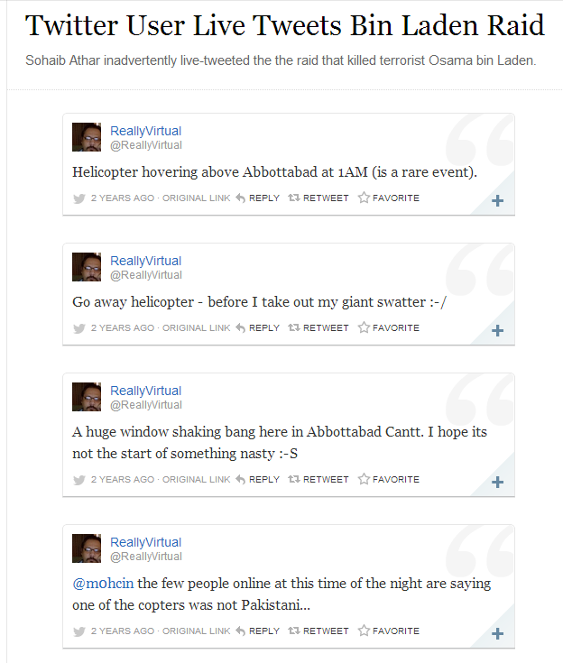
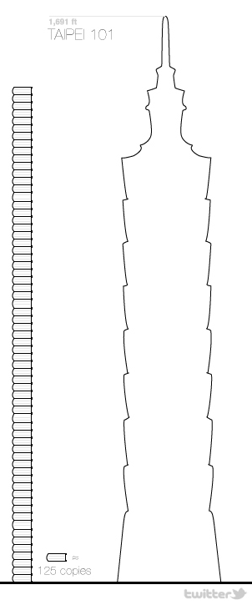
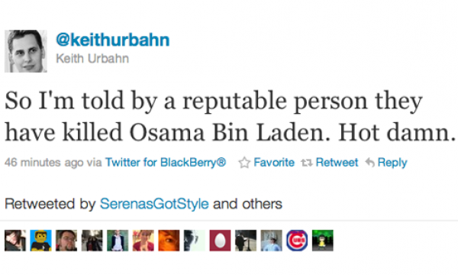


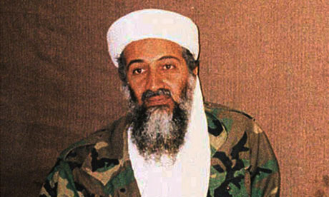




Rise of Informal Text
The internet has revolutionized how we communicate
Nobody can read all the tweets, clinical narratives, etc… which are written every day
Need text-processing systems to extract and aggregate important trends in the data
Notes:
-the internet has revolutionized the way people communicate.
-This has led to a flood of realtime, informal text available in electronic format, for example email, sms, twitter and also informal text generated in professional environments such as military field reports, or physicians notes.
-From my perspective, the interesting thing about informal text is that the volume produced each day is much larger than the volume of formal text such as books or newspaper articles.
-To make this a bit more concrete, if we were to take all the tweets written in a single day and print them into books, we would have a pile of books on the order of height of some of the highest buildings in the world.
-Clearly no person can read through all these messages, motivating the need for automatic text processing techniques to extract and aggregate the most important information.
-And there is a lot of important information that shows up first in informal text. One famous example is this Twitter user who inadvertently live-tweeted the raid that killed OBL.
----------------------------------------------------------------------------
In the meantime, the internet has revolutionized how we communicate. In the same way the printing press made it possible to broadly communicate ideas, the internet has made it possible for anyone to widely distribute information instantly and effortlessly.
The net effect of this is the availability in electronic format of huge volumes of informal text, including email, SMS, Twitter, Blogs, and even informal text generated in professional environments, for example physician’s narratives.
Compared to formal, published text such as newspaper articles or books, the volume of informal text generated every day is much larger. To give a concrete demonstration of the scale of this, if we were to take all the Tweets written in a day, print them into books, and stack those books on top of eachother, this pile of books would have comparable height to some of the worlds tallest buildings.
Clearly no person can read and analyze all the informal text generated each day, so we really need automatic text-processing techniques to extract and aggregate the most important information.
---------------------------------------------------
Pre-internet communication model:
-A few people publish media (e.g. newspapers), which are then broadcast to the masses
Post-internet communication:
-Everybody can broadcast information
-Leads to greater availability of information
-Information overload…
If you take all the tweets written each day, print them in books, and stack those books on top of eachother, it is comparable to the height of the world’s tallest buildings.
Clearly nobody can read all the tweets written daily and analyze this information.
-Really need some automated text processing techniques to extract and aggregate the most important information.
Twitter is just one example of the flood of informal text, others include text messages, transcripts from legal cases, physician’s narratives from EMRs. In this talk I will focus specifically on the informal text found in Twitter, but in future work, I am interested in exploring these other domains.
Dan: start with this slide…

Slide 3
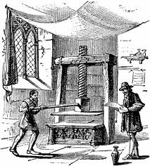

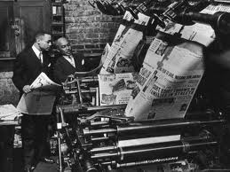
Background: Event Extraction from Newswire
Historically, the most important source of info on current events
Since spread of printing press
Lots of previous work on Newswire
MUC & ACE competitions
Timebank
Notes:
Of course there has been a ton of previous work on IE and NLP in newspaper articles.
This makes a lot of sense because historically news has been the best source of info on current events.
*******************************************************
A large portion of previous work on IE and NLP has focused on processing newspaper articles, so I think it’s worth stepping back for a second to ask why that is.
Historically newswire has been the best source of information on current events
Current events are a great application area for NLP
If our goal is to extract historical or encyclopedic information, then it’s very difficult to compete with manually curated structured data sources such as WP or FB.
But newswire is somewhat challenging for NLP applications as well, partly because it’s already quite well organized and edited.
It’s easy to keep up to date on current events by reading the newspaper every day.
***********************************************
A large portion of previous work on IE and NLP has focused on processing newspaper articles, so I think it’s worth taking a moment to reflect on why that is.
-Historically news articles have been the best source of information on current events (really since the spread of the printing press…)
Current events are a really good application area for NLP and IE
-If our goal is to extract encyclopedic knowledge, then it’s really difficult to compete with manually compiled structured data sources such as Wikipedia or Freebase, but if we’re extracting fresh information from news, then we have an opportunity to open up new data-analysis applications.
-One challenge for NLP applications on newswire text, however is that news is already very well organized. It’s fairly easy for a person to keep up to date on important events of the day by reading the newspaper.
********************************************************************************
If we just focus on extracting encyclopedic knowledge (information which is not new) from text, then it’s difficult to compete with manually compiled sources of structured data such as Freebase or Wikipedia.
People are more likely to mention new information using natural language than to fill out structured data forms, so by extracting up-to-date information about current events, we should be able to enable new data-analysis applications
*****************************************************************
Like I mentioned, most previous work on IE / NLP is focused on processing news articles. Since the NLP community is spending so much time working with this data, I think it’s worth stepping back a bit and evaluating why we’ve decided to do this, and whether it makes sense to shift our focus.
Newswire is a natural choice for NLP applications
-Historically newspapers have contained the best source of info on up to date info and current events.
-Clearly NLP can have a big impact by extracting machine processable information on current events
--if we just extract “old” information (that was already known), it’s difficult to compete with manually constructed structured data resources such as Freebase
-
-----------------------------------------------------------------------------------------
Why are we spending so much time working on NLP and IE from newswire? Certainly is a useful domain, but might be time to consider looking at others as well…
Think it’s worth keeping in mind why we’ve chosen this text genre to work on originally, and to evaluate whether it’s necessary to think about other types of text as well…
----------------------------------------------------------------------------------
Of course there has been tons of previous work on extracting events from newswire text.
This makes sense because historically news has been the best source of information on current events.
Examples include the Timebank corpus and the MUC and ACE competitions

Slide 4
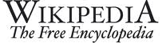

Background: Event Extraction from Newswire
Current Events: good application area for IE
Historical Information -> Difficult to compete
Challenge for NLP Applictions:
News is already well organized…
Notes:
Current events are a really good application area for information extraction.
If our goal is to extract historical or encyclopedic information, then it’s really difficult to compete with manually compiled structured data sources like WP or FB.
But news is also a challenging area for NLP applications. In part because news is already well organized.
It’s easy to keep up to date with the important news stories each day by reading the paper.
*****************************************
A large portion of previous work on IE and NLP has focused on processing newspaper articles, so I think it’s worth stepping back for a second to ask why that is.
Historically newswire has been the best source of information on current events
Current events are a great application area for NLP
If our goal is to extract historical or encyclopedic information, then it’s very difficult to compete with manually curated structured data sources such as WP or FB.
But newswire is somewhat challenging for NLP applications as well, partly because it’s already quite well organized and edited.
It’s easy to keep up to date on current events by reading the newspaper every day.
***********************************************
A large portion of previous work on IE and NLP has focused on processing newspaper articles, so I think it’s worth taking a moment to reflect on why that is.
-Historically news articles have been the best source of information on current events (really since the spread of the printing press…)
Current events are a really good application area for NLP and IE
-If our goal is to extract encyclopedic knowledge, then it’s really difficult to compete with manually compiled structured data sources such as Wikipedia or Freebase, but if we’re extracting fresh information from news, then we have an opportunity to open up new data-analysis applications.
-One challenge for NLP applications on newswire text, however is that news is already very well organized. It’s fairly easy for a person to keep up to date on important events of the day by reading the newspaper.
********************************************************************************
If we just focus on extracting encyclopedic knowledge (information which is not new) from text, then it’s difficult to compete with manually compiled sources of structured data such as Freebase or Wikipedia.
People are more likely to mention new information using natural language than to fill out structured data forms, so by extracting up-to-date information about current events, we should be able to enable new data-analysis applications
*****************************************************************
Like I mentioned, most previous work on IE / NLP is focused on processing news articles. Since the NLP community is spending so much time working with this data, I think it’s worth stepping back a bit and evaluating why we’ve decided to do this, and whether it makes sense to shift our focus.
Newswire is a natural choice for NLP applications
-Historically newspapers have contained the best source of info on up to date info and current events.
-Clearly NLP can have a big impact by extracting machine processable information on current events
--if we just extract “old” information (that was already known), it’s difficult to compete with manually constructed structured data resources such as Freebase
-
-----------------------------------------------------------------------------------------
Why are we spending so much time working on NLP and IE from newswire? Certainly is a useful domain, but might be time to consider looking at others as well…
Think it’s worth keeping in mind why we’ve chosen this text genre to work on originally, and to evaluate whether it’s necessary to think about other types of text as well…
----------------------------------------------------------------------------------
Of course there has been tons of previous work on extracting events from newswire text.
This makes sense because historically news has been the best source of information on current events.
Examples include the Timebank corpus and the MUC and ACE competitions

Slide 5


Social Media
Competing source of info on current events
Status Messages
Short
Easy to write (even on mobile devices)
Instantly and widely disseminated
Double Edged Sword
Many irrelevant messages
Many redundant messages
Information Overload
Notes:
Recently social media has emerged as an important competing source of information on current events.
The status messages written by users of these social networking websites have very different characteristics from news articles.
They are short, easy for anyone to write and are instantly and widely distributed.
For these reasons, social media often contains more up to date information on a wider variety of topics than news.
But this lowering of the barier to publication is a double-edged sword.
Because these messages are so easy to write, we end up with a lot of irrelevant and redundant information, leading to a situation of information overload.
Again this motivates the need for automatic text processing techniques.
***************************************************
Recently social media has emerged as an important competing source of information on current events. The status messages found on these social networing sites have several unique characteristics as compared with news: they are short, easy for anyone to write even on mobile devices, and are also instantly and widely disseminated. For these reasons Twitter often contains the most up-to-date info on current events.
Lowering the barrier to publication is kind of a double edged sword, however because this also leads to many irrelevant and redundant messages. No person can sit down and read all of the millions of Tweets written every day leading to a situation of information overload and motivating the need for automatic text processing techniques to extract and aggregate the most important information from Twitter.

Slide 6
Noisy Text: Challenges
Lexical Variation (misspellings, abbreviations)
`2m', `2ma', `2mar', `2mara', `2maro', `2marrow', `2mor', `2mora', `2moro', `2morow', `2morr', `2morro', `2morrow', `2moz', `2mr', `2mro', `2mrrw', `2mrw', `2mw', `tmmrw', `tmo', `tmoro', `tmorrow', `tmoz', `tmr', `tmro', `tmrow', `tmrrow', `tmrrw', `tmrw', `tmrww', `tmw', `tomaro', `tomarow', `tomarro', `tomarrow', `tomm', `tommarow', `tommarrow', `tommoro', `tommorow', `tommorrow', `tommorw', `tommrow', `tomo', `tomolo', `tomoro', `tomorow', `tomorro', `tomorrw', `tomoz', `tomrw', `tomz‘
Unreliable Capitalization
“The Hobbit has FINALLY started filming! I cannot wait!”
Unique Grammar
“watchng american dad.”
Notes:
OK, so the noisy, informal text we find on Twitter presents a number of challenges for NLP systems.
First there is a lot of lexical variation; Twitter users are very creative with their use of spelling and abbreviations.
As an example, I ran a distributional word clustering algorithm on a large corpus of tweets, then picked out and cleaned up one of the clusters.
Here you can see there are over 50 different ways people can refer to the word “tomorrow” on twitter. Clearly we aren’t going to see this same kind of lexical variation in news.
Tweets also contain unreliable capitalization. For instance people will often capitalize words simply for emphasis, or leave the whole message lowercased; this is particularly challenging for NE segmentation which relies heavily on capitalization.
Finally tweets have a unique grammar, for instance, users will often drop personal pronouns assuming the subject of the sentence refers to the speaker.
*****************************************************
On the other hand, shallow-syntactic annotation tasks are generally more difficult in Twitter because of their noisy and informal style.
First of all, people are really creative with their use of spelling and abbreviation; as an example, I ran a distributional word clustering algorithm on a large corpus of tweets, then picked out and cleaned up one of the clusters and you can see there are over 50 different ways to refer to the word “tomorrow”. Clearly you wouldn’t see this same kind of lexical variation in grammatical texts such as news articles.
Another problem is unreliable capitalization – People often capitalize words simply for emphasis or don’t capitalize proper nouns. This is a big problem for named entity segmentation which traditionally relies heavily on capitaliation.
Finally tweets have a unique grammar, for example we often see tweets which begin with verbs which isn’t common in news sentences.

Slide 7
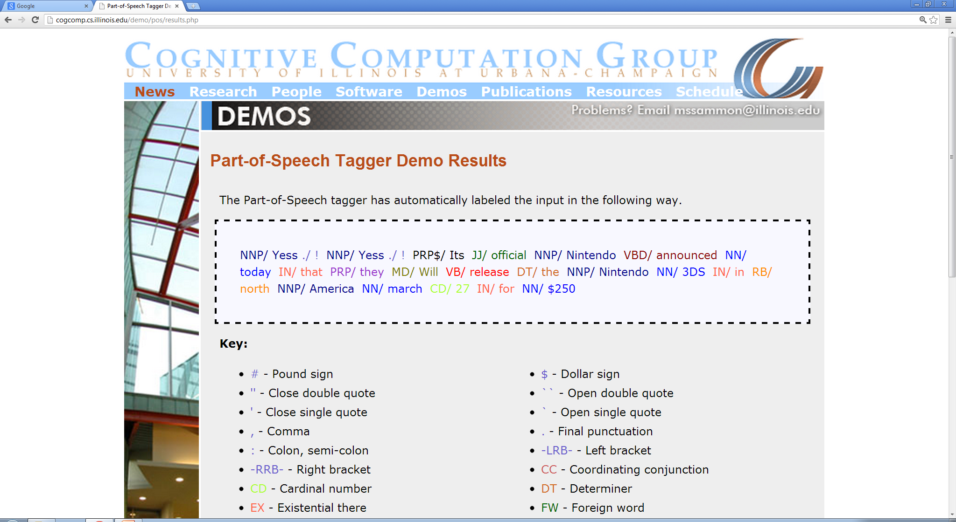
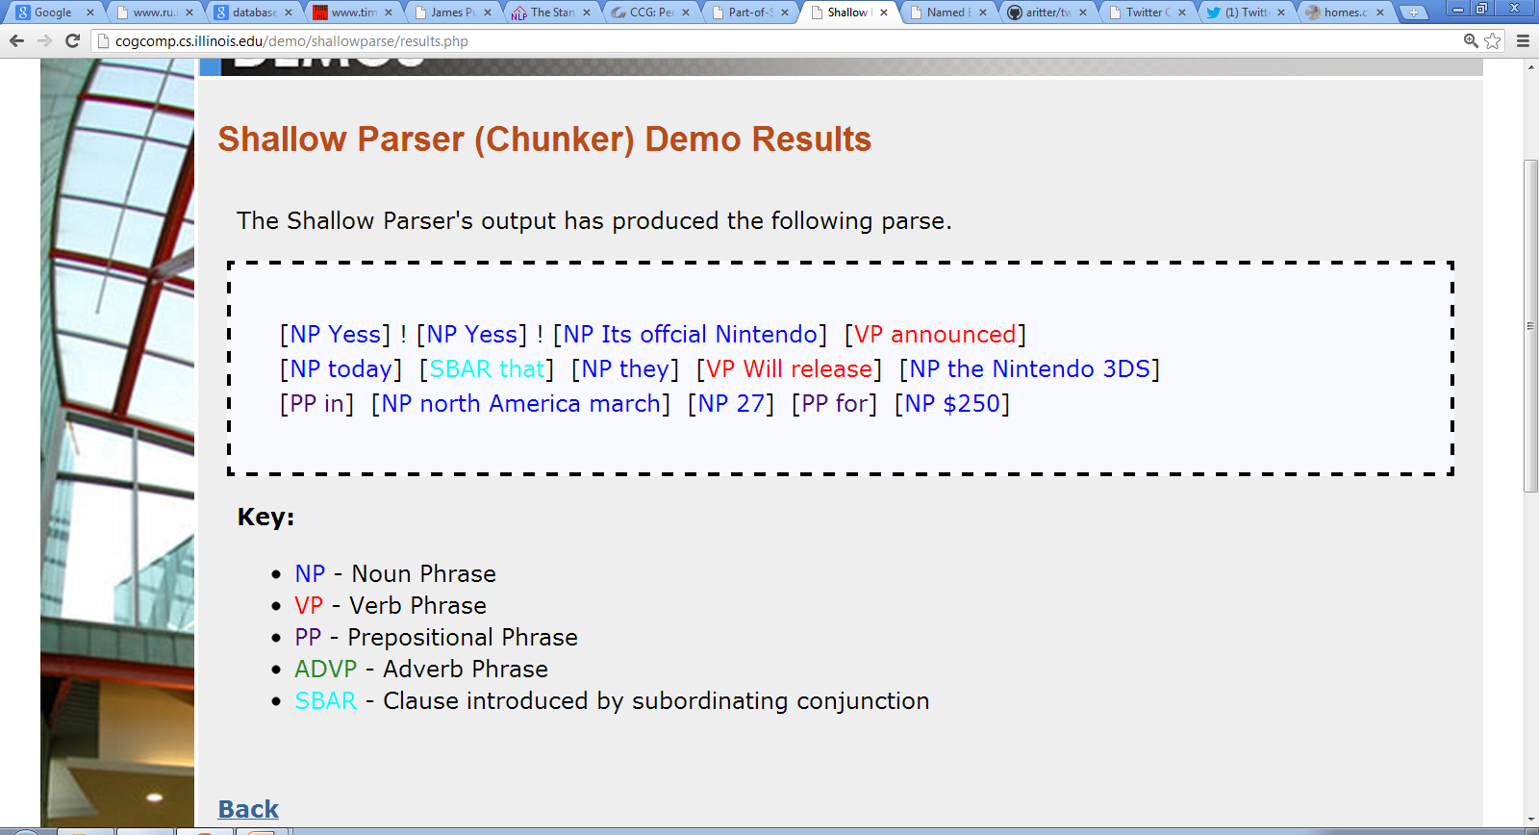
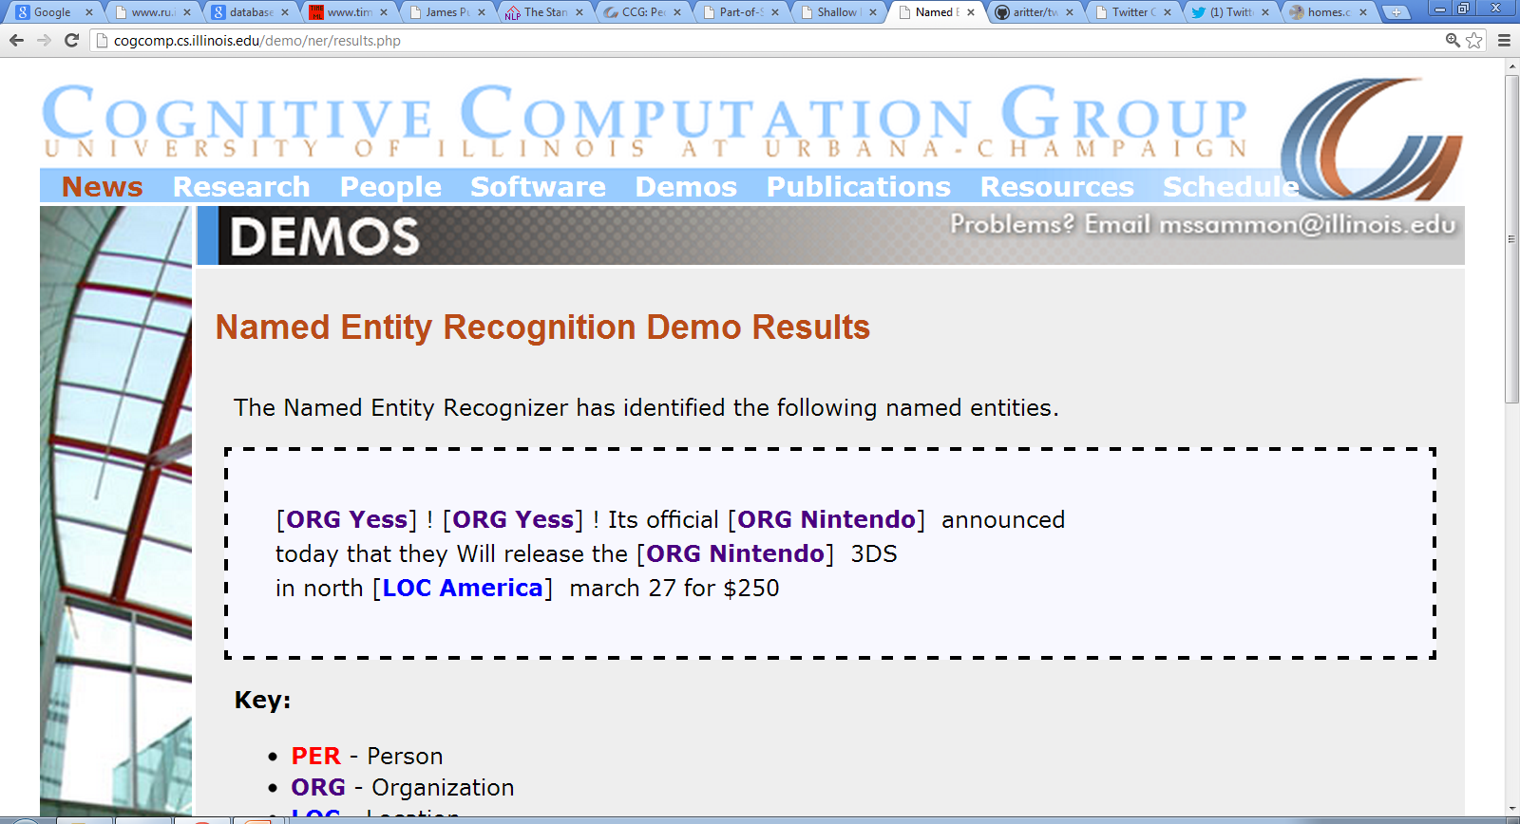
Let’s try NLP on Twitter…
Oops!
“Yess! Yess! Its ofﬁcial Nintendo announced today that they Will release the Nintendo 3DS in north America march 27 for $250”
POS:
Twitter Has Noisy & Unique Style
Chunk:
NER:
Notes:
OK, so you might be wondering how off-the-shelf NLP systems perform on Twitter.
And the answer is quite poorly.
For example the POS tagger here mis-categorizes “Yess” as a proper noun (because of the funny spelling).
The chunker mis-segments “Its official Nintendo” as an NP which is clearly a problem.
Also the NER mis-segments “America” as a location when in fact it should be “north America”.
OK, so this is just meant to demonstrate that Twitter has a noisy and unique style which systems tuned for grammatical texts weren’t meant to handle.
***********************************************************
OK, so hopefully I’ve convinced you we should be spending more effort on NLP and information extraction on informal text.
So the first question you might be asking is: how well to existing NLP tools work on Twitter?
And the answer is quite poorly.
For example you can see that Yess is mis-tagged as a proper noun (it’s a funny spelling).
“Its official Nintendo” is tagged as an NP which is clearly wrong.
And “America” is mis-segmented as a location (should be north america).
What’s going on here is that Twitter has a noisy and unique style which NLP tools designed for edited texts such as newspaper articles weren’t meant to handle.
************************************************************
TODO: fix the POS example (of-fi-cial)
Show example tweet and run off-the shelf tools on it.

Slide 8
Re-Building the NLP Pipeline for Twitter
Syntax
Annotate corpus of tweets (~2000)
Train in-domain sequence models
Word Clusters / Semi-supervised learning
Lexical Semantics
Supervised
POS
Shallow Parse
Entity
Event
Unsupervised
Named Entity
Classification
Event
Classification
Relation Extraction
Notes:
-To address these challenges I’ve re-built an NLP pipeline which is tuned to work specifically on noisy Twitter data.
-To do this, I’ve annotated a corpus of tweets with part of speech tags, shallow parse tags, named entities and events.
-These annotations are then used to train sequence models which can automatically annotate millions of Tweets streaming in realtime.
-We’re taking a mostly supervised approach to these syntactic annotation tasks.
-There is a lot of really interesting research on unsupervised learning for syntax. So far supervised methods perform better, and we’re trying to take a practical approach here.
-Informal text is highly diverse, however; therefore we need unsupervised learning methods which can leverage large quantities of unlabeled training data.
-I am going to talk about some unsupervised methods for information extraction, including named entity classification, event classification and relation extraction.
-I believe that unsupervised learning is a bit more practical for these more semantic tasks.
NEEDS PRACTICE
***************************************************************
-> Could think about using this as an outline for the talk (e.g. mention event categorization, named entity recognition and relation extraction on this slide…
TODO: Need to explain supervised / unsupervised distinction on this slide (this will tie together the later parts of the talk and make everything sound more coherent….)
-> coherent story = New domain, re-build some parts, unsupervised for other parts where appropriate, now I want to do this for more domains.
We are doing semi-supervised learning… Word clusters
Unsupervised methods for tasks like parsing and POS tagging generally don’t work very well as compared with a relatively small amount of labeled data
We’re interested in building something that works
Later in the talk I’ll talk about unsupervised and weakly supervised methods for information extraction which are well motivated in the context of noisy real-time text and I believe will generalize well to other domains.
TODO: somehow incorporate idea of unsupervised information extraction into this.
TODO: Explain Unsupervised vs. Supervised…
In addition we’re applying a number of unsupervised techniques for information extraction which I’ll get to later in the talk.
-For these syntactic annotation tasks, the strictly unsupervised techniques have been shown to have very poor performance compared with just a small amount of labeled data
-We’re really trying to take a practical approach here and actually get information extraction working on Twitter data, to ask what are the important questions which come up when we scale up to large datasets…
To address this, we’ve re-built an NLP pipeline which is tuned specifically for Twitter.
This includes POS tagging, Shallow parsing (or chunking), Named Entity Recognition, and Event tagging.
To do this, I annotated a corpus of tweets with each of these phenomenon, and trained in-domain sequence labeling models.
In addition we applied some unsupervised and weakly supervised methods which I’ll get to later in the talk.
**************************************************
To address this we’ve rebuilt an NLP pipeline for Twitter including POS tagging, shallow parsing, named entity recognition and event tagging.
I’m skipping over a bunch of details here, but by using a relatively small amount
in general our approach is to annotate a corpus of Tweets and train in-domain models.
We have also used some unsupervised and weakly supervised techniques here, some of which will come up later in the talk.

Slide 9
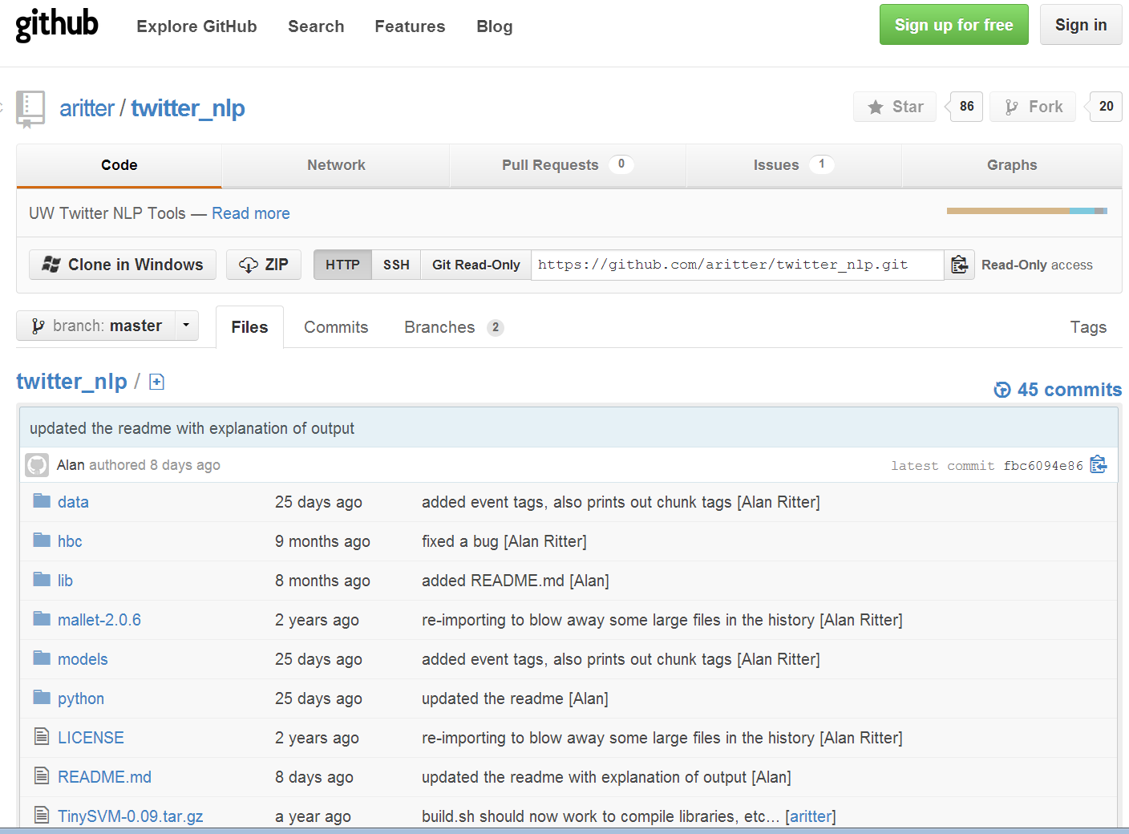
Improved NLP on Twitter
[Ritter et. al. EMNLP 2011]
Notes:
Here I’m showing our performance at each of these tasks, in comparison to out-of-domain models trained on news articles.
As you can see in each case we’re doing significantly better than the news-trained systems.
In addition we’ve made our NLP tools tuned for Twitter available on github, you’re welcome to download and try them out, and it appears that a bunch of people have been finding them useful.
********************************************
Here I’m showing performance at these various NLP tasks, comparing our system against off-the-shelf NLP tools tuned for newswire, and you can see that we’re doing much better.
And our tools are available on Github, a bunch of people seem to find them useful.
******************************************************
These are not the kind of accuracies and F1 scores you would expect to see for the same tasks in edited texts (e.g. news articles)
These tasks are more difficult in noisy text
***But my claim is that this is actually good enough in this domain, because we have other factors working in our favor***

Slide 10
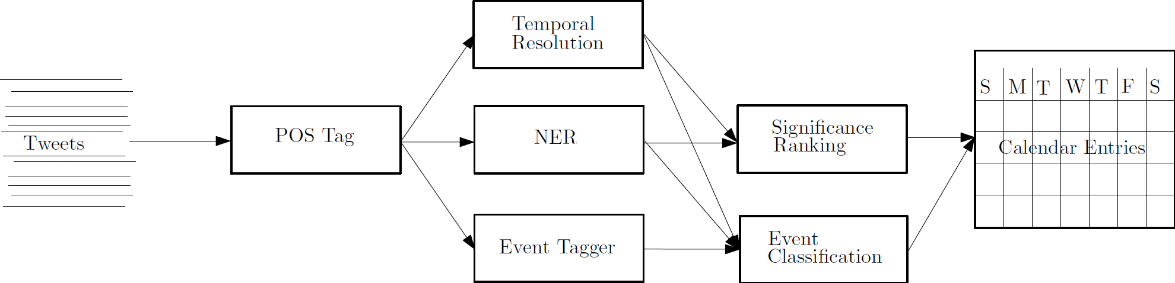

Extracting a Calendar from Twitter
[Ritter et. al. KDD 2012]
“Next Friday”
Tweets processed using in-domain NLP tools
https://github.com/aritter/twitter_nlp
1% sample of global Twitter stream
2 Million / Day
http://statuscalendar.cs.washington.edu/
Notes:
Given that we’ve built a set of NLP tools for Twitter, a natural question is: now what can you do with them?
To give one answer to this question, I’ve built a system which automatically extracts a calendar of popular events occurring in the near future.
To do this, we process a constant stream of tweets with our NLP tools, extracting named entities and event phrases.
In addition we also extract and resolve temporal expressions, for instance if we see a phrase like “next Friday”, we can figure out the exact calendar date it’s referring to since we have the timestamp from when the tweet was written.
Then we count the number of times each named entity co-occurs with a reference to each date, and plot the most strongly associated entities for each day on a calendar.
Also I’d just like to highlight that there are a number of interesting systems issues behind the scenes here as well; I’m not going to go into much detail on this, except to say we had to use a distributed nosql database since standard relational databases couldn’t keep up with the inserts.
**********************************************************
Given that we’ve built these tools, the next natural question is: what can we do with them?
To demonstrate the utility of NLP / IE in Twitter, I’ve built a demonstration which extracts a calendar of popular events from Twitter.
To do this we process a constant stream of about 2M tweets per day, running our NLP tools on them to extract named entities, events, and we also extract and resolve temporal expressions for example…
Then we simply count the number of times each named entity co-occurs with a reference to each date, and plot the most strongly associated entities for each date on a calendar.
Also I’d just like to highlight that there are some interesting systems issues going on here, I’m not going to go into any detail on this other than to say that we had to use a distributed nosql database since a standard relational database couldn’t keep up with the inserts.
OK, so I’ll open up the demo now…
*********************************************************************
-Extract Named Entities, event phrases, etc…, and… (explain)
-Highlight systems issues?
-Show demo

Slide 11
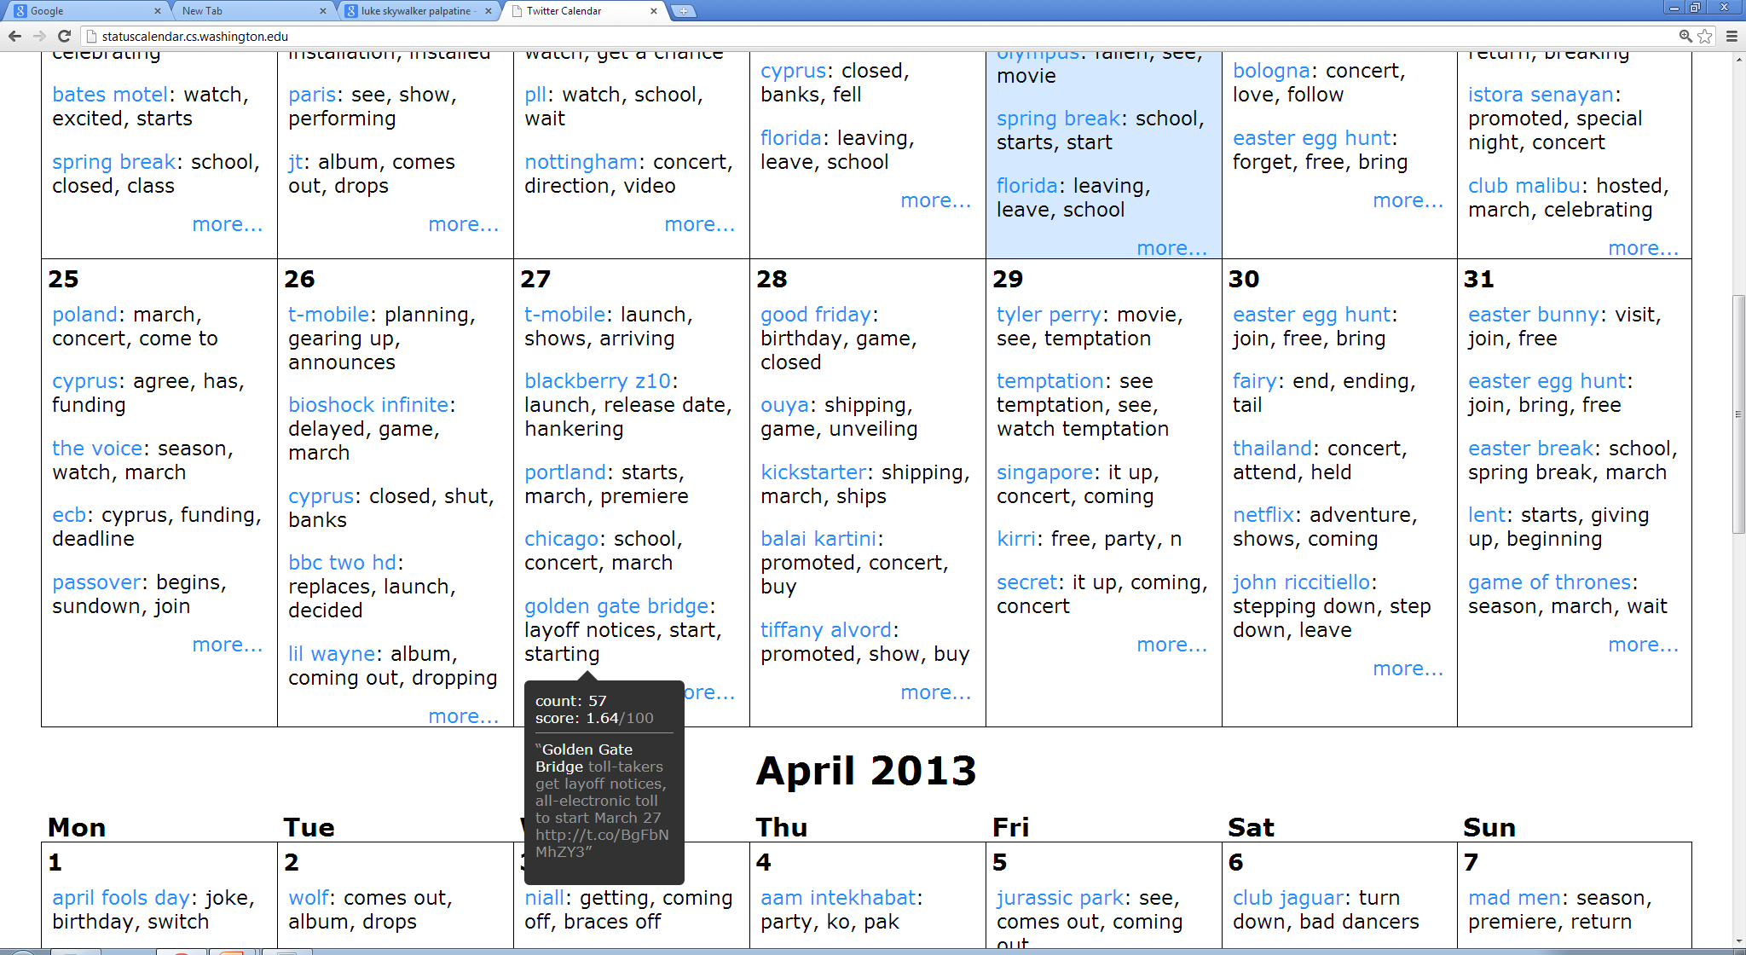

Slide 12
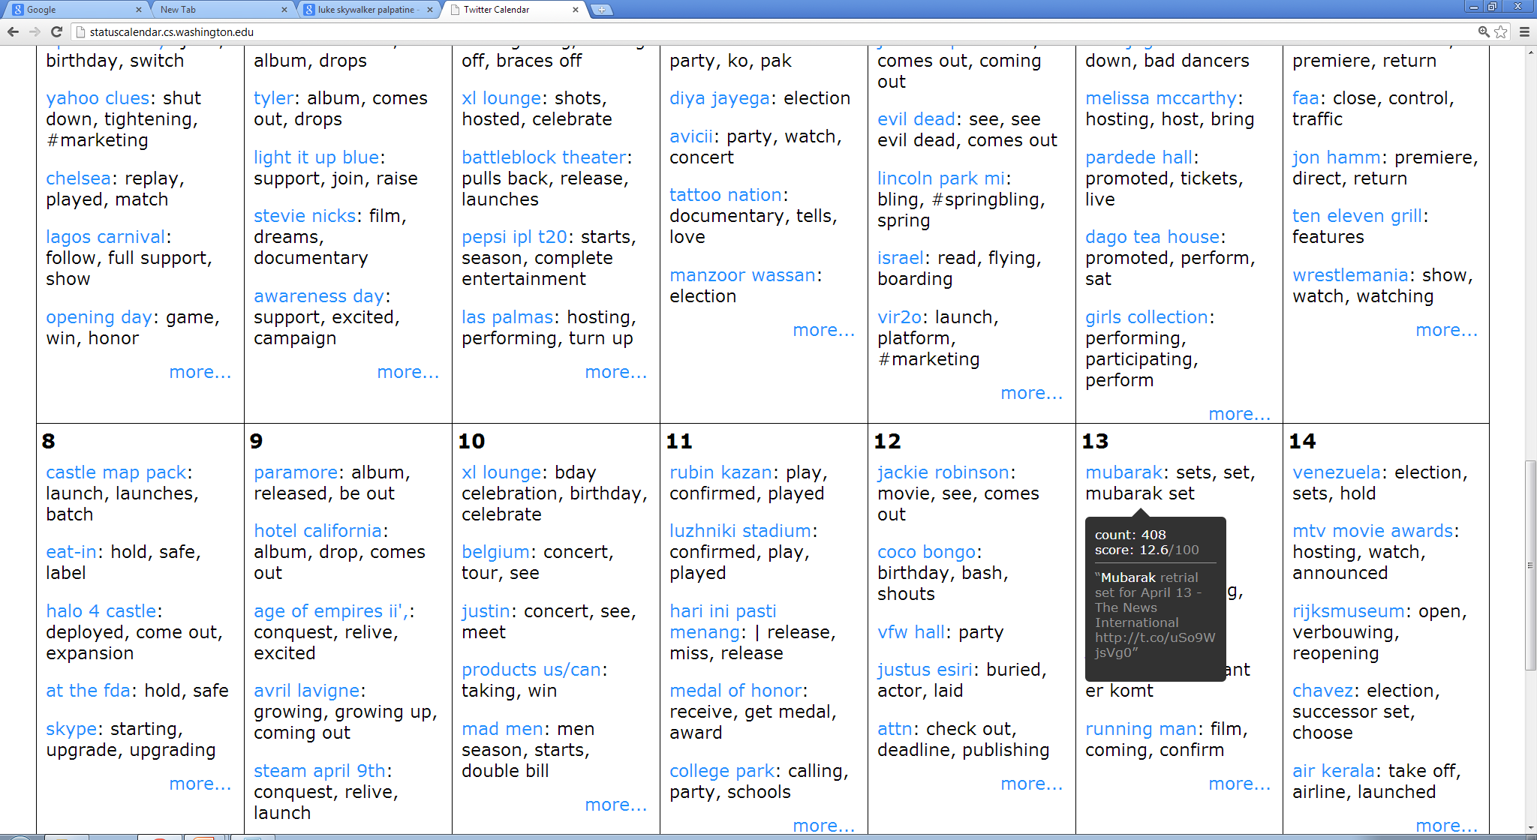

Slide 13
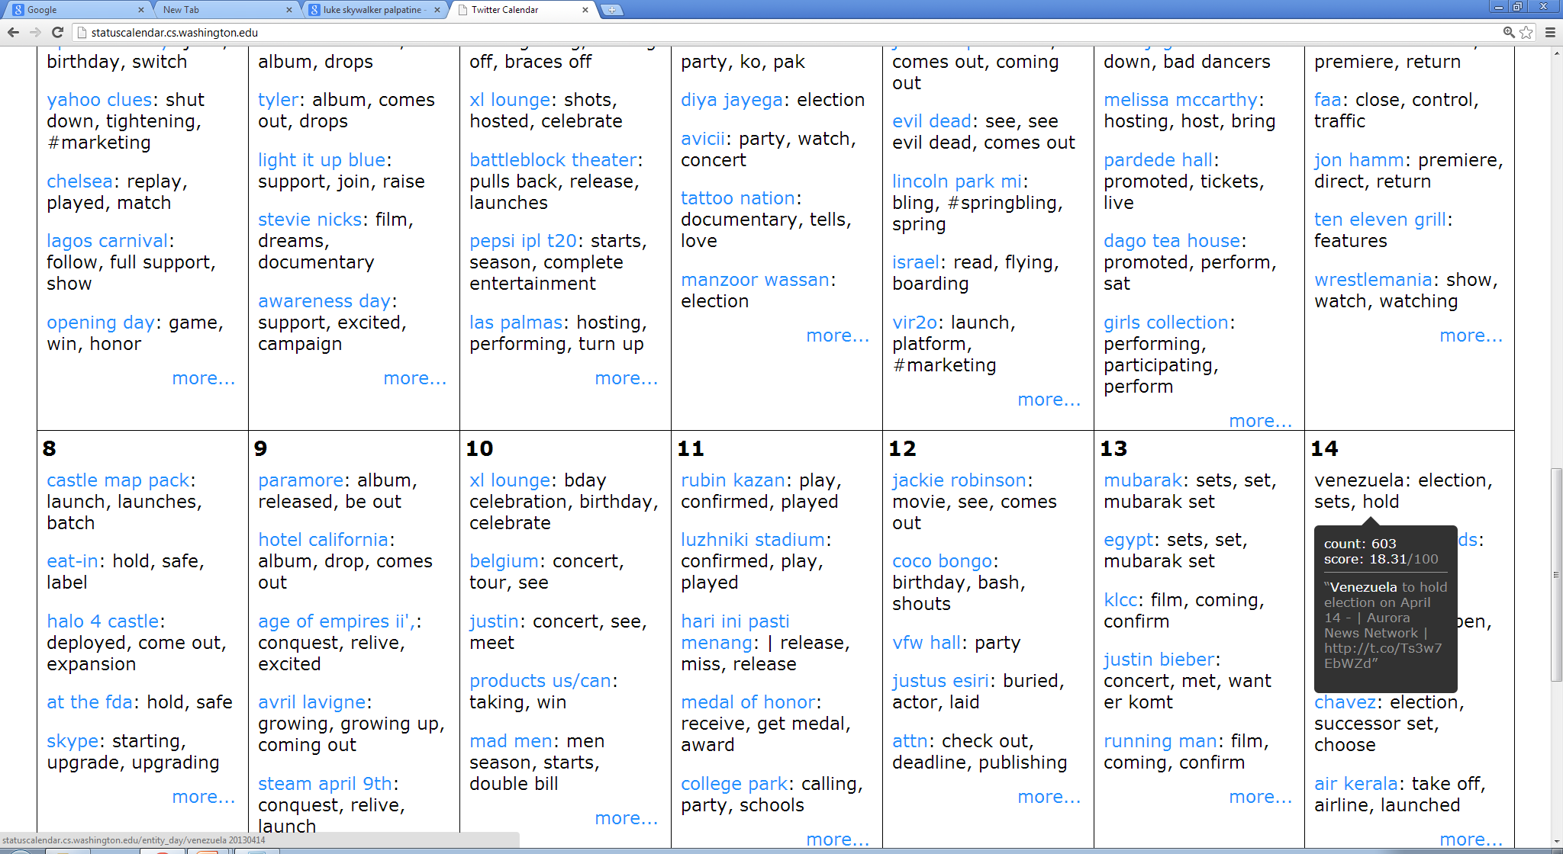

Slide 14
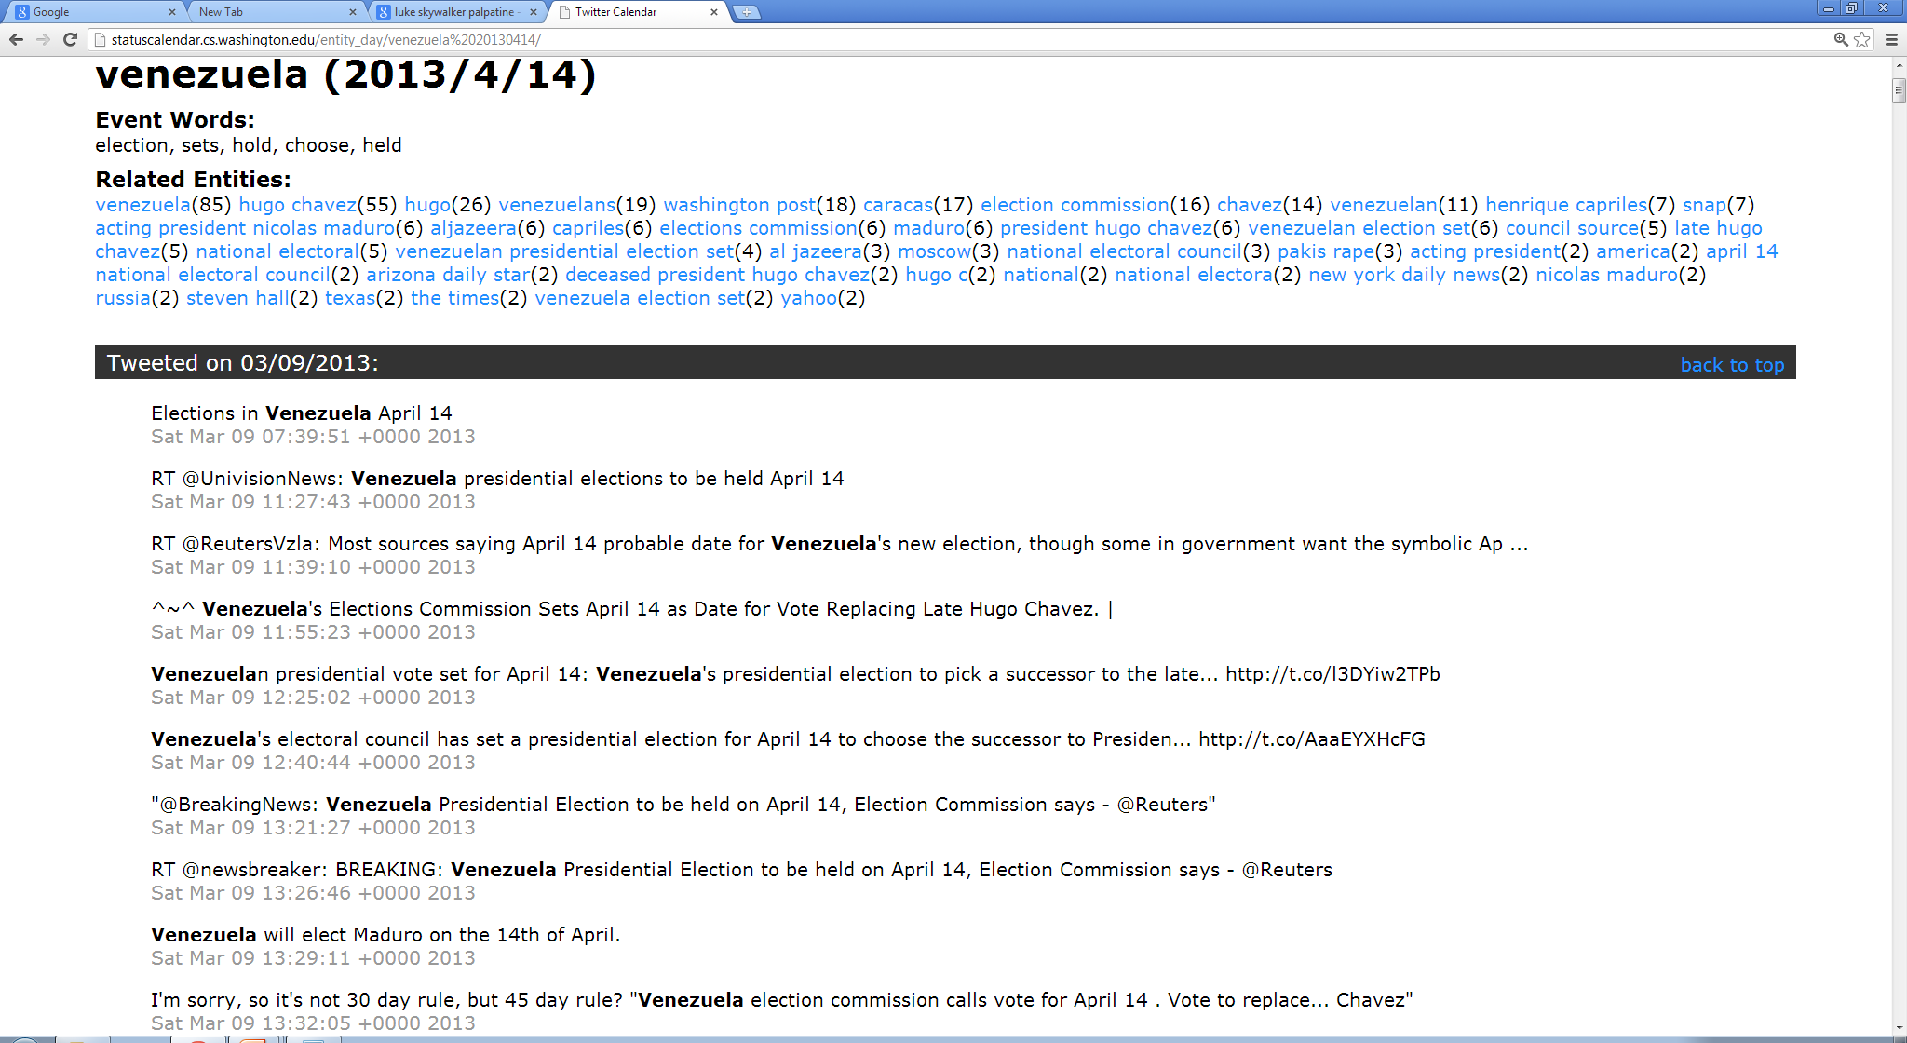

Slide 15

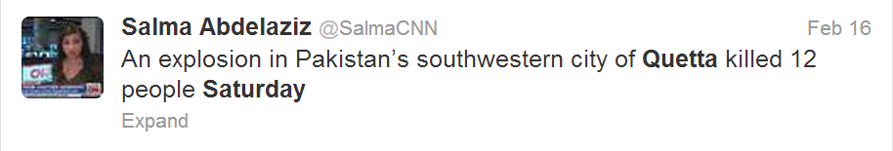
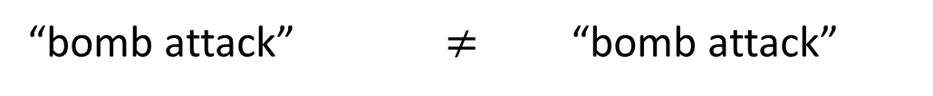
Question: Why does this work?
… 79 people … have been killed in a
bomb attack in … city of Quetta.
At least 79 people are now said to have been killed in a bomb attack in a predominantly Shia Muslim part of the south-western Pakistani city of Quetta.
The blast, which also wounded 180 others, ripped through a crowded market place in an ethnic Hazara area at around 18:00 (13:00) on Saturday.
The blast, which also wounded 180 others, ripped through a crowded market place in an ethnic Hazara area … on Saturday.
A twin suicide bomb attack at a crowded snooker club on 10 January killed ...
“The blast” happened on Saturday
“The blast” == “bomb attack”
“bomb attack” $≠$ “bomb attack”
Notes:
So we were actually surprised to see that this works so well, since extracting open-domain events from news articles is a very challenging task.
For instance, in this example to figure out when the “bomb attack” mentioned in the first sentence takes place, we need to recognize that “the blast” mentioned in the second sentence is referring to the same event, and also that “the blast” happened on Saturday.
Furthermore we also need to recognize that this second “bomb attack” refers to a totally separate event which happened on a different date.
Extracting events from news articles requires complicated discourse processing to link information across sentences.
In contrast tweets have very simple discourse structure.
To see why that is: when a user writes a message on twitter, it’s assumed it will be mixed up in the feeds of all their followers, so no context is typically assumed.
In contrast sentences in a news article are meant to be understood within the context of the article, so there is a tendancy to spread information across sentences with the assumption that the reader will be able to link it together.
By working with short informal messages from Twitter, we’re able to side-step some of these difficult discourse issues.
*********************************************************************
*** PROBLEM AREA ***
We were actually surprised by how well we can extract open-domain events from Twitter.
In news articles this event extraction task is quite challenging.
For instance, in this example to figure out when the “bomb attack” mentioned in the first sentence took place, we need to recognize that “the blast” mentioned in the second sentence is referring to the same event, and also that “the blast” took place on Saturday.
Furthermore, we have to realize that the “bomb attack” mentioned later in the article is referring to a totally separate event which happened on a separate date.
These discourse issues dealing with linking information across sentences are some of the more challenging and unsolved problems in NLP.
In contrast Twitter has very simple discourse structure.
When a user writes a message on Twitter, it is mixed up in the feeds of all their followers, so they don’t assume any discourse context, and state things quite plainly.
In contrast sentences within a news article are meant to be understood within the discourse context of the article, so information tends to get spread across sentences.
So by working with these short informal messages on Twitter we’re able to sidestep some of these complicated discourse issues.
************************************************************
You might be surprised that this works so well.
open-domain event extraction is a difficult task, because of the difficult discourse problems that come up.
In this example to figure out when the bomb attack in the first sentence took place, we need to recognize that “the blast” is referring to the same event, and also that the second “bomb attack” is talking about a totally separate event.
Tweets, on the other hand have very simple discourse structure.
When a user writes a message on Twitter, it gets mixed up in the feeds of their followers, so no discourse context is typically assumed.
For this reason, information in Tweets is typically stated in a simple straightforward way.
***************************************************
OK, so I think the results here actually look pretty good, one natural question you might ask is: why does this work so well?
-If you think back to earlier in the talk, I mentioned that open-domain event extraction is quite difficult because of these challenging discourse-related issues.
-The reason for this is that most Tweets have very simple discourse structure. Whereas sentences in news articles are meant to be understood within the discourse context of the article, Tweets are assumed to be randomly mixed up in the feeds of the authors followers, so they don’t assume any context, and state information in a fairly straightforward way.
Like I mentioned, current NLP technology is pretty good at processing sentences independently, but currently not so great at handling these discourse-related tasks such as coref, so in some sense the current state of the technology is better suited to extracting information from Tweets than news.
----------------------------------------------------------------------------------
Discourse is hard!!!!
Coref
Event/time relations
-------------------------------------------------------------------------
Points to get across in this slide (needs to be re-written):
Typical NLP pipeline
Synatx: POS, Parse, NER – These all work pretty well
Discourse: Anaphora, event reference resolution, linking events to temporal expressions – These are difficult (unsolved) problems
→Semantics: Representing the meaning of language – This is what we really care about to enable data analysis applications (we want this!!!)
-----------------------------------------------------------------------
TODO: really need to improve this example…
Slide is on the right track but needs to be rewritten
------------------------------------------------------------------
POS tagging
NER
Parsing
Coreference resolution / Discourse processing
Slot filling

Slide 16



Categorizing Events
…
Sports
Politics
Product Release
Notes:
Given that we can do a good job of extracting open-domain events from twitter, the next natural question is whether it’s possible to categorize these into high-level types for example sporting events, politics, product releases and so on.
This categorization would have a number of benefits, most obviously allowing users to browse more customized calendars which match their interests, but I believe it would be useful for a number of other upstream tasks as well.
*********************************************************************
Would like to categorize events into types, for example:
Sports
Politics
Product releases
…
Benefits:
Allow more customized calendars
Could be useful in upstream tasks
Move towards semantics
Disambiguats + resolves synonyms…
TODO: PICTURES!!!!
Categorizing the events will have several important benefits.
Most obviously, event types could be useful for displaying more customized calendars which are adapted to user’s interests. For example you might want to see a calendar of upcoming movie releases or sports events…
In addition these high-level types could be useful for a variety of upstream tasks such as summarization.

Slide 17
Categorizing Events: Challenges
Many Different Types
Not sure what is the right set of types
Set of types might change
Might start talking about different things
Might want to focus on different groups of users
Notes:
There are a number of challenges in categorizing events on Twitter, however.
Most notably there are a huge number of different types of events that get discussed on Twitter.
In advance it’s not even clear what the best set of categories are.
Furthermore the set of important categories could change over time as new topics become more important.
Or if we want to focus in on a specific group of users, a different set of event categories might best desribe the data.
*************************************************************************
Categorizing event open-domain events from twitter presents several challenges.
Most importantly there is a huge variety of different types which are important to capture.
In addition it’s not even clear apriori which set of event types are appropriate, and the set of important types could shift over time as different topics become more or less popular.
Also for a specific group of users different types might be appropriate.

Slide 18
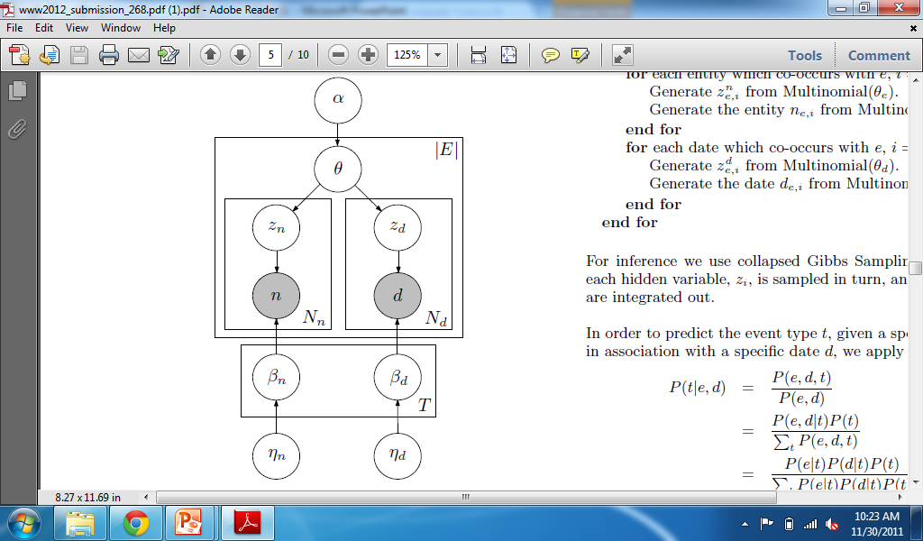
Solution: Unsupervised Event Type Induction
Latent Variable Models
Selectional Preferences
[Ritter et. al. ACL 2010]
Advantages:
Discovers types which match the data
No need to annotate individual events
Don’t need to commit to a specific set of types
Notes:
To address these challenges we’re proposing an unsupervised approach to event-type induction based on latent variable models.
This approach has a number of advantages, it’s able to automatically discover an appropriate set of event types which match the data.
We don’t need to annotate any individual events in context.
Further, we don’t need to commit to a specific set of event types in advance. If we get some new data we can just re-run our model to find new types which best describe that data.
***********************************************
To address these issues we’re proposing an approach to unsupervised event type induction based on latent variable models.
This approach has several advantages; we’re able to automatically induce an appropriate set of event types which match the data, there is no need for expensive annotation, we don’t need to commit to a specific set of event types in advance.

Slide 19
Generative Probabilistic Models
Make up a generative story involving:
hidden variables
Probabilities
Apply Bayesian Inference techniques
Gives us reasonable values for hidden variables
Tells us what we want to know
Notes:
So how these generative models work is we first make up a story about how our data was generated involving probabilities and hidden variables.
Then we apply bayesian inference techniques to infer reasonable values for the hidden variables which tell us what the category of each event is in context.
*********************************************
To address these issues we’re proposing an approach to unsupervised event type induction based on latent variable models.
This approach has several advantages; we’re able to automatically induce an appropriate set of event types which match the data, there is no need for expensive annotation, we don’t need to commit to a specific set of event types in advance.

Slide 20
Unsupervised Event Categorization: Generative Story
cheered
win
announce
Apple to announce new iPhone…
Samsung will announce Tuesday…
Obama to announce new plan...
Lakers announce Pau Gasol will…
Microsoft to announce new …
…
Types:
Microsoft 0.04
Samsung 0.02
iPhone 0.01
…
Obama 0.04
Clinton 0.03
Boehner 0.02
…
Ravens 0.04
Lakers 0.03
Pau Gasol 0.02
…
Notes:
I’m going to walk through the generative story for our data.
First we group together all tweets which mention the same event phrase.
Next we’ll have a set of event types. Each type has an associated probability distribution over named entities.
For example we might have a type for product releases which assigns high probability to entities like MS, Samsung and iPhone, and similarly a type for politics and sports.
Now for each event phrase, we’ll pick a random distribution over these types.
******************************************************
OK, so how these generative models work is we make up a story about how our data was probabilistically generated involving hidden variables.
Then we apply Bayesian inference techniques to infer reasonable values for the hidden variables, which tell us what the event types are and the category of each event in context.
I think it will help to make it clear what’s going on here if I walk through the generative story in the context of our data.
***********************************************************************
Our approach is based on Latent Dirichlet Allocation, so I’d like to give an intuitive explanation of the generative story for LDA in the context of our data to try and give an idea of what’s going on here.
LDA is an admixture model for grouped data, so we’ll start by grouping together all tweets which mention the same event phrase.
Next we’ll pick a set of types, each of which will have an associated probability distributions over named entities involved of events of the type.
So for example a type representing product releases might contain entities like Microsoft Samsung and the Iphone, and similarly we could have types representing political and sports events.
Now for each event phrase in our data, we’ll pick a random probability distribution over these types.
******************************************************************
I’d like to give some intuition about how this works by giving an intuitive explanation of Latent Dirichlet Allocation in the context of our data.
LDA is an admixture model for grouped data, so we’ll start out by grouping together all tweets which mention the same event phrase (for example announce).
Then we’ll pick a set of topics, where each topic has an associated probability distribution over named entities and dates, for example we might have a topic corresponding to product releases which assigns high probability to entities like Microsoft, Samsung, and the iPhone, a topic for politics and sports and so on.
Next for each event phrase, we pick a distribution over these topics…

Slide 21
Unsupervised Event Categorization: Generative Story
cheered
win
announce
Apple to announce new iPhone…
Samsung will announce Tuesday…
Obama to announce new plan...
Lakers announce Pau Gasol will…
Microsoft to announce new …
…
…
Types:
Microsoft 0.04
Samsung 0.02
iPhone 0.01
…
Obama 0.04
Clinton 0.03
Boehner 0.02
…
Ravens 0.04
Lakers 0.03
Pau Gasol 0.02
…
PRODUCT RELEASE
POLITICS
SPORTS
Notes:
Then to generate each named entity in our data, we repeatedly draw a type from this distribution then pick an entity from the associated type distribution.
Again this just describes the generative story for our model; we aren’t ever going to generate data in this way.
Instead we’ll apply bayesian inference techniques to infer reasonable values for the hidden variables which tell us what the types are and what is the type of each entity in context.
***********************************************************
Then for each named entity in our data, we first pick a type from this distribution, and then pick the entity from the associated type distribution.
In practice we’re not actually going to generate data in this way, but instead we’ll apply bayesian inference techniques to infer values for the hidden variables which will tell us:
What the event types are
The category of each event in context
*****************************************************************************
So this just describes the generative story for our data, of course we won’t generate data in this way, but instead given a set of observed event phrases and named entities, which co-occur together in tweets, we’ll apply bayesian inference techniques to infer values for the hidden variables which tell us what the event types are and also categorize the events in context.

Slide 22
Experimental Details…
Gathered about 65M (entity, event, date) tuples
Collapsed Gibbs Sampling
1,000 iterations of burn in
Parallelized sampling (approximation) using MPI
[Newman et. al. 2009]
100 Event Types
Notes:
OK, so here are a few experimental details before I show the results.
We gathered about 65M entity-event-date tuples (basically the events from the calendar)
For inference we used collapsed gibbs sampling which is a standard approach for these kinds of models.
Actually we used a parallelized approach to sampling.
Gibbs sampling is an inherently sequential proceedure, but there are some theoretical results which explain how the parallelization can be viewed as an approximation to the sequential proceedure.
In practice we found this to work really well, and it lets us scale up to much larger datasets.
****************************************************
OK, so here are a few experimental details before showing results…
We gathered 65M events and inferred event types using collapsed Gibbs sampling.
Actually we used a parallelized approximation to the Gibbs sampling procedure which allows us to scale up to more data, and we found to work well in practice.
And we used 100 event types
--Parallelized approximation to gibbs sampling – Gibbs Sampling is an inherently sequential procedure – we’re throwing theoretical guarantees from MCMC out the window, but we do find this to work very well in practice, and there is some theoretical justification which explains that this process as an approximation to the true Gibbs sampler.

Slide 23
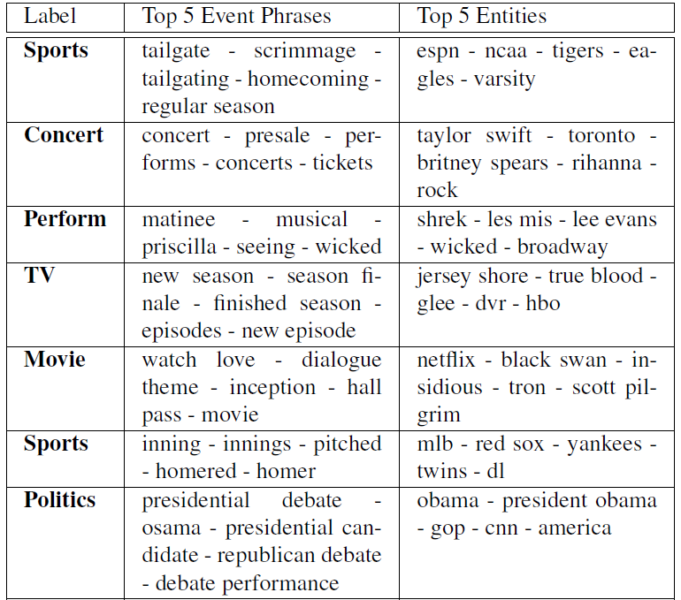
Notes:
Here are some examples of the types automatically discovered by our model
I think these look pretty good.
For example we can see a clear “sports” category which assigns high probability to event phrases like “tailgate, scrimmage, homecoming, regular season” and also to named entities like “espn, ncaa, tigers and eagles”.
We also see a nice TV category which has event phrases like “new season, season finale, new episode” and also named entities such as “jersey shore, true blood and glee” and also TV networks like hbo
**************************************************************
Here are a few examples of event types automatically discovered by our model. For example you can see a clear “sports” event which includes event words such as “tailgate”, “scrimmage”, “homecoming”, and entities such as “ESPN”, “NCAA”, “Tigers”, “Eagles”, etc…

Slide 24
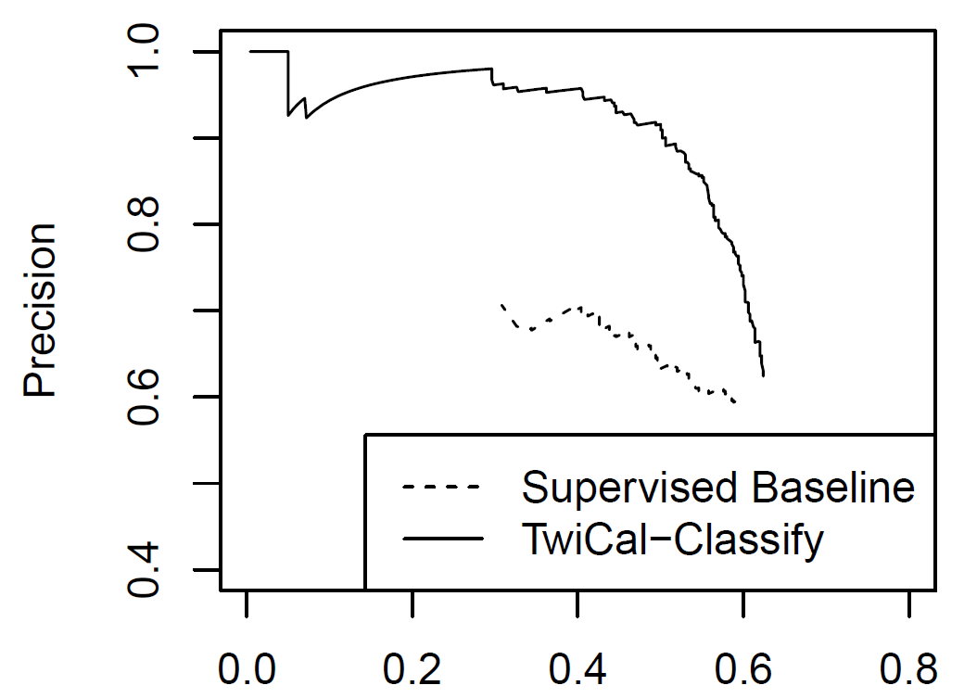
Event Classification Performance
Notes:
We also evaluated how well our event type model can categorize events in context.
Here I’m showing a precision/recall curve compared against a supervised baseline.
You can see that by using large amounts of unlabeled data we’re able to do much better.
****************************************************
Here I’m showing precision recall curves for event type categorization. As you can see our approach is doing much better than the supervised baseline, since it’s able to use large amounts of unlabeled data whereas the supervised baseline only has access to 500 labeled examples.

Slide 25
Named Entity Categorization: Exploiting Structured Data
Unsupervised Learning
Advantages:
scale to large unlabeled datasets
agnostic to categories
Question: what if we have structured data?
Freebase
Distant Supervision
Database + text
Learn to extract relations
e.g. [Wu and Weld 2007], [Mintz et. al. 2009]
Notes:
OK, so this unsupervied approach to learning has a number of advantages.
It lets us scale up to large unlabeled datasets, and is agnostic to the correct set of categories.
An interesting question is what to do in the situation where we have access to large amounts of structured data, for example from Wikipedia or Freebase.
This is the case for the named entity categorization task, we can easily get large lists of named entities and their types.
A popular approach to leveraging large quantities of structured data and unlabeled text is Distant Supervision, so we decided to look at distant supervision in the context of this named entity categorization task.
*************************************************
**** PROBLEM AREA *****
-This unsupervised approach is great, because it lets us scale up to large (unlabeled) datasets, and allows us to remain agnostic to the correct set of categories in the data.
-An important question is what to do in situations where we have large structured datasets available (e.g. Freebase/Wikipedia)
-One popular approach to using structured data to train relation extractors without labeled data is Distant supervision

Slide 26
Named Entity Categorization: Challenges
Plethora of distinctive, infrequent types
Bands, Movies, Products, etc…
Very Little training data for these
Can’t simply rely on supervised learning
Very terse (often contain insufficient context)
Notes:
Classifying named entities on Twitter is also challenging, because there many different types of entities people talk about, for example bands, movies, products and so on.
Many of these categories are relatively infrequent, so even in a large manually annotated training dataset we will have few labeled examples.
For this reason I think we can’t just rely on supervised learning in this situation.
************************************************************
Classifying named entities in tweets is a challenging task for two reasons:
There are many distinctive and infrequent types, for example bands, movies, products etc… We’d really like to use a more fine-grained classification than the standard Person/Location/Organization
Secondly tweets are often very terse, without enough context to determine an entity’s type. For example here it would be very difficult to know what type of entity “KKTNY” is referring to without any background knowledge
-----------------
Classifying Named Entities in Tweets is also a challenging task.
Many distinctive infrequent types
Tweets are often very terse
For example, without any background knowledge it would be very difficult to know what type of entity “KKTNY” is referring to.

Slide 27
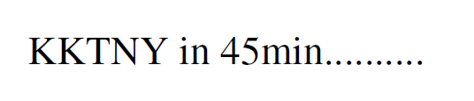
Named Entity Categorization: Challenges
Plethora of distinctive, infrequent types
Bands, Movies, Products, etc…
Very Little training data for these
Can’t simply rely on supervised learning
Very terse (often contain insufficient context)
Notes:
Another challenge is that tweets are often very terse, and lack enough context to determine the types of the entities they mention.
For example in this instance it’s very hard to tell what kind of entity KKTNY is referring to without some additional background information.
********************************************
Classifying named entities in tweets is a challenging task for two reasons:
There are many distinctive and infrequent types, for example bands, movies, products etc… We’d really like to use a more fine-grained classification than the standard Person/Location/Organization
Secondly tweets are often very terse, without enough context to determine an entity’s type. For example here it would be very difficult to know what type of entity “KKTNY” is referring to without any background knowledge
-----------------
Classifying Named Entities in Tweets is also a challenging task.
Many distinctive infrequent types
Tweets are often very terse
For example, without any background knowledge it would be very difficult to know what type of entity “KKTNY” is referring to.

Slide 28
Weakly Supervised NE Classification
Freebase lists provide a source of supervision
But entities often appear in many different lists, for example “China” could be:
A country
A band
Several people
A film (released in 1943)
Notes:
To address both of these challenges, we’re proposing a weakly supervised approach to named entity categorization which uses large lists of named entities and their types as a distant source of supervision.
Of course we can’t simply look up a named entity to figure out it’s type in context, for example if we look up “China” in FB, we see that it could refer to a country, a band, there are several people named “China”, or a film.
**************************************************************
TODO: describe freebase…
TODO: confusing: previous systems do disambiguation???
-------------------------------------------
To solve both these problems we’re proposing a weakly supervised approach to classification, using large dictionaries of named entities as a source of distant supervision
Of course we can’t simply look up an entity to classify it’s type, for example if we look up “china” in FB, we see it could refer to a country, a band, there’s also a person who’se
Name happens to be “china”, and so on.
So we need some way to disambiguate between these different possibilities
--------------------------------------------
To solve both these problems, we use a weakly supervised approach to classification.
-Use lots of unlabeled data (plenty of examples for infrequent types)
-Share information about a types mention across contexts (helps deal with terseness)
Use Freebase type lists as a source of supervision
Problem: entity mentions are highly ambiguous (often belong to many types)
Example: china
Need some way to disambiguate types

Slide 29
Weakly Supervised NE Classification
Freebase lists provide a source of supervision
But entities often appear in many different lists, for example “China” could be:
A country
A band
Several people
A film (released in 1943)
We need Some way to disambiguate
Notes:
We need some way to disambiguate between these posibilities.

Slide 30
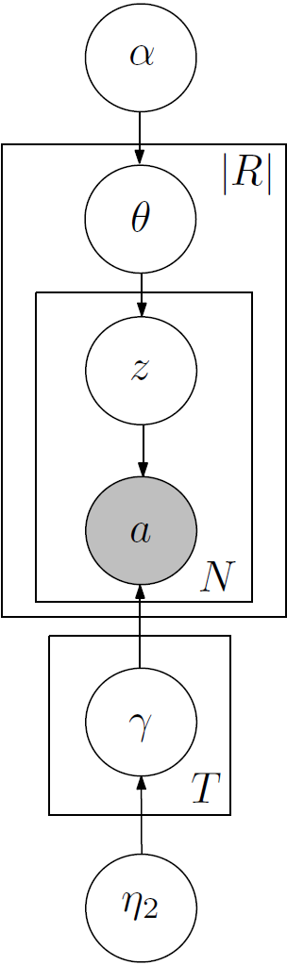

Distant Supervision with Latent Variables
[Ritter et. al. EMNLP 2011]
Applying DS directly to NER doesn’t work
Training data is too ambiguous…
Proposed solution:
Latent Variable Models for Named Entity Categorization
With constraints
[Elsner et. al. 2009]
[Ramage et. al. 2009]
Notes:
To do this we’re proposing a new approach to distant supervision based on latent variable models.
Like I alluded to on the previous slide, just applying distant supervision directly to this problem doesn’t work because the training data is too ambiguous.
Instead we’re proposing to use an approach based on constrained latent variable models, similar to LabeledLDA, which is a model for labeled document collections.
In this case we’re using constrained topic models for weakly supervised named entity categorization.
****************************************************
TODO: relationship to LabeledLDA:
We’re proposing an approach which uses the Freebase dictionaries as constraints in the model
This is similar to LabeledLDA which uses constrained topic models to model collections of labeled documents
Here we’re using a similar method for categorizing named entities.
Like I alluded to on the previous slide, simply applying distant supervision directly to this problem doesn’t work in practice because the data is to ambiguous.
To address this, we’re proposing a new approach to distant supervision based on constrained topic models.
****************************************************
Different possibilites
China -> Highly ambiguous according to Freebase…

Slide 31
Distant Supervision with Latent Variables
[Ritter et. al. EMNLP 2011]
Obama
Apple
JFK
On my way to JFK early in the…
JFK 's bomber jacket sells for…
JFK Airport’s Pan Am Worldport…
Waiting at JFK for our ride…
When JFK threw first pitch on…
X
…
Entity Types:
‘s 0.04
threw 0.02
jacket 0.01
…
waiting 0.04
ride 0.03
way 0.02
…
announced 0.04
new 0.03
release 0.02
…
PERSON
FACILITY
PRODUCT
Notes:
OK, so I’ll walk through the generative story here.
First we group together all tweets which mention the same named entity (note this is different from last time when we grouped together all tweets with the same event phrase).
Then we’ll have a set of entity types. Each type has an associated probability distribution over words which co-occur in context with mentions of that type of entity.
Next, for each entity we pick a distribution over these types.
The key difference here is that these entity-type distributions are constrained by the FB dictionaries.
For example we might look up JFK in Freebase and see that it could refer to either a person or an airport.
*******************************************************
To explain how this works, again I’m going to walk through the generative story for LDA in the context of this problem.
First we’ll group together all tweets which mention the same named entity.
-Note that this grouping is different from what we used for event categorization
Then we’ll have a distribution over context words associated with each named entity category
Now for each entity, we’ll pick a distribution over types
The main difference here is that this distribution is constrained based on the freebase dictionaries
For example if we look up JFK in Freebase, we’ll see that it could refer to a person or an airport
-So we’ll eliminate categories which are inconsistent with these possibilities
Then we just proceed as before repeatedly picking a topic from this constrained distribution, and then picking a context word from the associated type distribution.
Again, this is just the generative story for the data, in practice we’ll apply bayesian inference techniques to infer values for the hidden variables which tells us the category of each entity in context.
*********************************************************
For named entity categorization, the setup is going to be a bit different.
First we’ll group together all tweets which mention the same named entity (as opposed to the same event phrase)
Then we’ll have a set of entity types which correspond to a probability distribution over context words which co-occur with entities of that type
Each entity will have an associated probability distribution over types
In this case (unlike before) the set of possible types will be constrained by the Freebase dictionaries, for example if we look up JFK in Freebase, we might see that it could refer to either a person or an airport, so we’ll constrain the distribution over types to correspond to only these two posibilities.
******************************************
In this case we’re going to do things a bit differently, instead we will group together all tweets which mention the same named entity, and each entity type will have an associated probability distribution over words which co-occur with entities of that type in context.
First off, we will look up each named entity in Freebase to constrain it’s set of possible types, for example we might look up JFK and see that it could refer to either a person or an airport (that is a facility).

Slide 32
Distant Supervision with Latent Variables
[Ritter et. al. EMNLP 2011]
Obama
Apple
JFK
On my way to JFK early in the…
JFK 's bomber jacket sells for…
JFK Airport’s Pan Am Worldport…
Waiting at JFK for our ride…
When JFK threw first pitch on…
X
…
…
Entity Types:
‘s 0.04
threw 0.02
jacket 0.01
…
waiting 0.04
ride 0.03
way 0.02
…
announced 0.04
new 0.03
release 0.02
…
PERSON
FACILITY
PRODUCT
Notes:
Then to generate each context word in our data, we repeatedly draw a type from the constrained distribution, and then draw a word from the associated type distribution.
Again, this is just an intuitive explanation of the generative process, in practice we’ll apply bayesian inference techniques to infer values for the hidden variables which will tell us the type of each entity in context.
**************************************************
Then like before, for each context word in our data, we’ll first pick a type from that distribution, then draw a context word from the associated type distribution.
Again, this is just a “story” about how our data we’re generated, and we’re not going to actually do this in practice, but instead we’ll apply bayesian inference techniques to infer reasonable values for the hidden variables which tell us the type of each entity in context.
****************************************
Then we just proceed as before generating the context words in our data by first picking entity types from the named entity’s distribution, and then drawing words from the associated type distribution.
And again, just to emphasize, this is just an intuitive description of the generative story behind LDA in the context of our data; in practice we will apply inference to find a good assignment to the hidden variables in our model.

Slide 33
Data/Inference
Gather entities and words which co-occur
Extract Entities from about 60M status messages
Used a set of 10 types from Freebase
Commonly occur in Tweets
Good coverage in Freebase
Inference: Collapsed Gibbs sampling:
Constrain types using Freebase
For entities not in Freebase, don’t constrain
Notes:
OK, so we gathered named entities and context vectors from about 60M status messages.
We also used a set of 10 named entity types which we found to have good coverage in FB, and were also frequently mentioned on twitter.
For inference we again use collapsed gibbs sampling, where we constrain the type distributions based on the Freebase dictionaries.
If we look up an entity and don’t find it in FB, then we simply leave it’s distribution over types unconstrained.
***********************************************
We gathered named entities and their context vectors from about 60M status messages
We used a set of 10 named entity categories which had good coverage in Freebase, and were also relatively frequent in Twitter.
For inference, we used collapsed gibbs sampling where we constrain the distribution over types based on the FB dictionaries.
If we look up an entity and don’t find it in FB, we simply leave it’s type distribution unconstrained.
*************************************************
Experimental details:
We ran our named entity segmenter I described earlier on about 60M tweets
Built a set of 10 mutually exclusive dictionaries from Freebase. We picked dictionaries which have good coverage of entities we found in tweets.
For inference we use Collapsed Gibbs sampling, constraining the hidden variables using the FB dictionaries.
If an entity doesn’t appear in FB, then we simply leave it’s distribution over types unconstrained
Extract entities from about 60M tweets
Group words into documents (each entity is a “document”)
Use Collapsed gibbs sampling for inference (1000 iterations)
-Constrain sampling using Freebase types

Slide 34
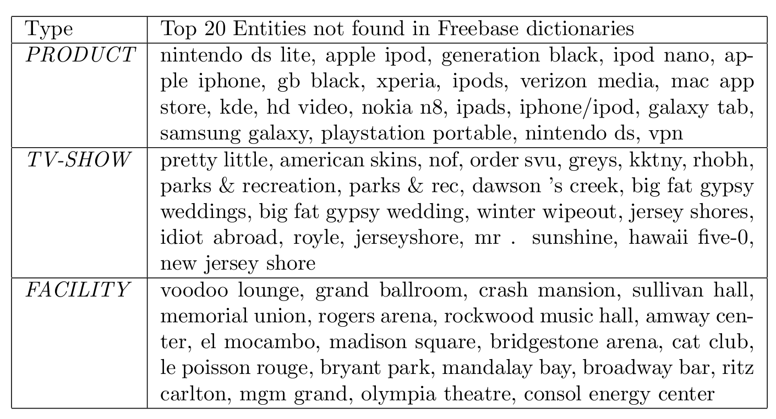
Type Lists
Notes:
Here are some example type lists automatically generated by our model.
These are just 3 out of the 10 types (and I should mention these are some of the more difficult types).
For each type I’m listing the top 20 entities which assign highest probability to the type and didn’t appear in FB.
In general these look pretty good. For products we’re seeing things like “nintendo ds lite….”….
**************************************************
Here are some example type lists (for 3 of the 10 types) generated by our model.
These are some of the more difficult types, it works even better for things like PERSON and LOCATION
In general I think these look pretty good, for products we’re seeing things like “nintendo ds lite”, “apple ipod”, “ipod nano”, and so on.
************************************************************
Just to show that our model is actually doing something useful, here I’m some example lists of entities for 3 of the 10 types.
For each type, I’m showing the top 10 entities which assign highest probability to that type. For example for the product type, we’re seeing entities like …. – there are some segmentation errors here as well
-----------------------------------------------------------
Just to give some idea that the inferred type distributions make sense for unseen entities, here I’ve listed the top 20 entities which don’t appear in any FB dictionary for a few selected types.
For the most part these look good, there are a few segmentation errors.
This also highlights one reason why we can’t just rely on Freebase: may entities on twitter are abbreviated, so we wouldn’t expect to find them.
--------------------------------------------------------
-For each type, the 20 entities which assign highest probability are listed
-These are entities which didn’t appear in any Freebase type list (topics were unconstrained)
This shows that Twitter is a good domain for this type of thing, e.g. we can figure out the types of some entities which weren’t in Freebase:
-Entities which are very new (not yet in Freebase)
-Abbreviations

Slide 35
Type Lists
KKTNY = Kourtney and Kim Take New York
RHOBH = Real Housewives of Beverly Hills
Notes:
I think what’s really cool here is that our model is able to correctly categorize these Twitter-specific abbreviations you wouldn’t expect to find in Freebase.
*******************************************
One thing that is interesting is that our model is able to correctly categorize these Twitter-specific abbreviations which we wouldn’t expect to find in dictionaries such as FB.

Slide 36
Classification Results: 10 Types
25% increase in F1
[Collins and Singer 1999]
Notes:
We also evaluated the ability of our model to categorize named entities in context.
Here I’m showing our results compared against a number of baselines.
For example we do better than a supervised baseline, which does quite well on the more frequent categories like person and location, but does poorly on the less frequent categories which don’t show up much in the training data.
We also compared against the co-training apprroach to weakly supervised NE categorization proposed by collins and singer.
We’re getting a pretty big improvement in performance here.
*******************************************************************
We also did an evaluation to see how well our model can categorize named entities in context
Here I’m comparing our approach against a bunch of baselines
Including a supervised baseline which does quite well on the more frequent categories like person and location, but does poorly on the less frequent ones like bands and products for which there are few examples in the training data.
We also outperform the co-training approach to weakly supervised named entity categorization proposed by collins and singer.
Here I’m showing results on the NE classification task.
I’m comparing our system against a bunch of baselines including a supervised classifier trained using 10 fold cross validation and the co-training approach to weakly supervised named entity categorization proposed by collins and singer.
And note that LabeledLDA on the right is doing the best in this case.
***
Moving left-to-right, first notice that the majority class baseline of always predicting the most frequent cateogory “PERSON” gets an f1 score of about .3
We also looked at a simple Freebase baseline which only makes predictions if the entity appears unambiguous according to FB
Next we comparaed against a supervised baseline which is trained on the 2400 annotated tweets using 10 fold cross validation – this actually did very well on the frequent categories like PERSON and LOCATION, but performed very poorly on the less frequent types since there are few examples in the training data.
Finally we compared against the co-training approach to weakly supervised named entity classification proposed by collins & singer, and our approach based on labeled-lda does the best.
------------------------------------------------------
Here I’m showing results of NE classification using the gold segmentations provided in the data (later I have results on seg+class). First of all the majority baseline of always predicting the most frequent class “PERSON” gets an F1 score of about 0.3. Next we have a baseline which only makes predictions if the entity appears totally unambiguous according to Freebase; this does a little bit better, but the important thing to note here is that this is fairly high-precision (used for seeding the Co-training baseline, and also LabeledLDA). Next we have a fully-supervised baseline which uses a maximum entropy classifier trained using 4-fold cross-validation over the manually annotated data. Finally LabeledLDA gets almost 0.7 F1 score on this task.

Slide 37
Why is LDA winning?
Share type info. across mentions
“KKTNY in 45 min…”
“Watching KKTNY tonight on TV”
Explicitly models ambiguity
Each “entity string” is modeled as (constrained) distribution over types
Takes better advantage of ambiguous training data
Ambiguous
TV Show
Notes:
OK, so why is it that LDA is winning here?
I think there are two reasons for this.
First, it’s able to share information about an entity’s type across it’s mentions.
This is helpful for these ambiguous cases where there isn’t enough context in a single tweet.
Secondly by using the FB dictionaries as constraints in the model we’re explicitly modeling the ambiguity in the training data, which is very important for this named entity categorization task, since the FB dictionaries are so ambiguous.
*******************************************************
***** PROBLEM AREA ******
Why is LDA winning here?
First, it’s able to share information about an entity’s type across mentions.
This can help to disambiguate ambiguous mentions where a person might have trouble figuring out the type of the entity based on other less ambiguous mentions.
Secondly this approach explicitly models ambiguity in the training data as constraints
So it’s better able to take advantage of the highly ambiguous training data provided by the Freebase dictionaries.
************************************************
KKTNY example…
------------------
Pop back up to the high-level point here, we can learn to categorize large numbers of entity types without any supervision…
---------------------------------------------------------------
So why is it that LDA is winning here? I think there are two reasons for this:
First of all, it’s able to share information about an entity’s type across it’s mentions, this is very helpful in cases where there isn’t enough context information to correctly classify a mention.
Secondly, because our model is incorporating the Dictionaries as constraints, it’s able to take better advantage of this ambiguous source of training data
---------
Why is it that LDA is winning?
One thing is that Labeled LDA is able to share information about an entity’s possible types across it’s mentions. If one mention is relatively unambiguous, this can help to disambiguate the type of other more ambiguous mentions.
Another thing is that LabeledLDA is better able to take advantage of the ambiguous training data provided by Freebase. It doesn’t rely only on the “unambiguous” entities.

Slide 38
Distant Supervision: A Natural Question
What about missing data?
Leads to errors in the training data
General problem:
Affects both NER and Binary relations
Binary Relations →
Lots of overlapping / highly correlated features
E.g. dependency paths, word sequences, etc…
Conditional Models are better
Don’t make bad independence assumptions
Notes:
OK, so I’ve just finished talking about a new approach to distant supervision based on topic models which is able to handle highly ambiguous training data.
There was a natural question which came up when we were working on this.
That is: what happens when there is missing data in either the text or the database?
The answer it leads to errors in the training data.
This is a very general problem that affects distant supervision both for named entity categorization and extracting binary relations.
So we decided to look at this problem in the context of extracting binary relations.
Most IE systems for binary relatios make use of a lot of overlappign and highly correlated features, for example dependency paths, word subsequesnces, and so on.
The generative models I’ve been talking about so far don’t work very well in this situation because they make strong independence assumptions about the features.
So instead we’ll look at this problem in the context of conditionally trained models.
***************************************************************
***** PROBLEM AREA ******
OK, so I just finished talking about a new approach to distant supervision based on topic models which is able to better handle the case where the training data is highly ambiguous.
So a natural question came up while we were working on this, was what happens when information is missing from either the text or the database?
-The answer is that it leads to errors in the training data.
-This motivated us to look into models which explicitly model missing data
I should probably point out up front this is work in progress, we haven’t submitted a paper on this yet, but I do have some recent results that I’m pretty excited about.
**************************************
Now I’m going to talk about some very recent unpublished work I’ve been doing. I have some experimental results to show and we’re planning to write this up and submit to TACL.
MENTION: Very recent (unpublished) results; work in progress; I will show some experimental results, we’re planning to write this up and submit to TACL.
So far I’ve presented an approach to distant supervision which is able to handle more ambiguous weakly supervised training data.
We noticed a natural question while working on this problem.
Distant supervision is a great approach, because it allows us to leverage lots of data to extract knowledge from text.
I’ve talked about how we can better leverage this ambiguous training data using constrained topic models in the context of fine grained NER.
There are still unsolved problems, however…
Example: missing data.
Leads to false negatives in the training data…

Slide 39
Missing Data in Distant Supervision
e.g. [Mintz et. al. 2009]
(Albert Einstein, Ulm)
(Mitt Romney, Detroit)
(Barack Obama, Honolulu)
Person | Birth Location
Barack Obama | Honolulu
Mitt Romney | Detroit
Albert Einstein | Ulm
Nikola Tesla | Smiljan
… | …
“Barack Obama was born on August 4, 1961 at … in the city of Honolulu ...”
“Birth notices for Barack Obama were published in the Honolulu Advertiser…”
“Born in Honolulu, Barack Obama went on to become…”
…
Notes:
PROBLEM AREA
OK, so in distant supervision for binary relations we have access to a large number of instances of a target relation.
Then we gather a bunch of sentences which mention pairs of entities from the realtion.
Now we can extract features from these sentences and treat them like positive examples of the relation.
But what happens if some data is missing here?
Now all these sentences are effectively negative training examples which is clearly problematic.
This is a pretty common situation. These databases are incomplete and there is a lot of missing data.
********************************************************
***PROBLEM-AREA****
In distant supervision we have access to both a database and a large text corpus.
For example Freebase contains large lists of people and their birth locations.
And if we search the web for pairs of these entities, we can find lots of sentences which mention them.
For example here are a few sentences which mention Barack Obama and Honolulu.
OK, so each of these entity pairs become positive examples for the relation we’re trying to extract (in this case birth-location), we extract features from these sentences and train a supervised classifier to recognize instances of the relation for new pairs of entities.
********************************************************************
In Distant supervision we have access to a structured database, for example Freebase contains a list of birth locations for many individuals.
Then we look through a large text collection and find all the sentences which mention people and their birth locations, for example all the sentences that contain Barack Obama and Honolulu.
Then features are extracted from each group of sentences, and these entity pairs are treated as positive examples of the relation for a supervised classifier.
-Negative instances are just random pairs of entities.

Slide 40
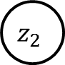
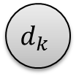

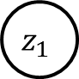

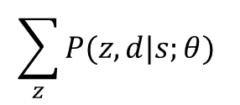
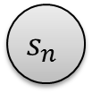
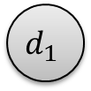

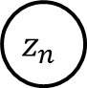

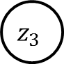
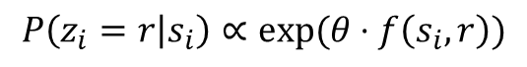
Distant Supervision (Binary Relations)
[Hoffmann et. al. 2011]
(Barack Obama, Honolulu)
$$s_{1}$$
$$s_{2}$$
$$s_{3}$$
…
$$s_{n}$$
Sentences
Local Extractors
$$P\left(z_{i}=r | s_{i}\right)∝exp⁡(θ⋅f\left(s_{i},r\right))$$
$$z_{1}$$
$$z_{2}$$
$$z_{3}$$
…
$$z_{n}$$
Relation mentions
Deterministic OR
$$d_{1}$$
$$d_{2}$$
…
$$d_{k}$$
Aggregate Relations
Maximize
Conditional
Likelihood
(Born-In, Lived-In, children, etc…)
$$\sum_{z}{P(z,d|s;θ) }$$
Notes:
OK, so I’ll walk through a model for distant supervision in the case of binary relations before getting into the details of how we’re going to model this problem of missing data.
To start out, we have a pair of entities (for example BO, HI)
We get to observe a lot of sentences which mention the entity pair.
Then we have a classifier which predicts the relation mentioned in each sentence.
In a standard supervised learning setup we’d get to observe these variables at training time.
But in this case we only get to see these aggregate-level variables which tell us which relations hold between BO and Honolulu from Freebase.
So how do we relate the aggregate relations with the sentence-level relation mentions?
One answer is a simple deterministic-OR function.
Basically this says that if any of the sentences mention that BO was born in Honolulu, then the fact is true, otherwise if none of them mention it, it is false.
Conversely, if FB mentions that BO was born in HO, then at least one sentence has to mention it.
To tune the parameters of our classifier we can maximize the conditional likelihood of the observed data in freebase conditioned on the observed sentences.
********************************************
Here I’m showing a graphical model representation of the MultiR system for distant supervision which was developed at the University of Washington by Raphael Hoffmann and others.
Here we are extracting binary relations
So for each pair of entities, we have all the sentences which mention them,
We also have a set of local extractors which give us a probability distribution over the relation mentioned in each sentence
Also we have a set of aggregate variables which indicate whether each relation is true between the entity pair
So how do we determine if a relation is true based on the sentence-level relation mentions?
Well this is just a simple deterministic OR function.
Basically this says, for example, that if any of the sentences mention that BO was born in Honolulu, then it’s true and if none of the sentences mentions this, it is false.
*************************************************************
OK, so here is a graphical model representation of MultiR which was developed by Raphael Hoffmann and others at UW.
For each pair of entities (e.g. Obama and Honolulu) we have all the sentences in our data which mention the pair.
Then we have a set of factors which look af features of the sentences and give us a probability distribution over the possible relations mentioned in each sentence.
And we have these aggregate level variables which tell us for each relation whether it holds between the pair of entities.
So how do we tell whether a relation holds? Well this is simply a deterministic OR function.
Basically this just says that if any of the sentences mention that barack obama was born in Honolulu, then it’s true, conversely if none of the sentences mention this, then the fact is false.
*****************************************************
TODO: mention simpler model without latent variables
--------
-This is one recent state-of-the art approach to this problem which applies a markov network involving latent variables.
-Basically we have a set of classifiers which determine for each sentence which mentions a pair of entities (say Mitt Romney and Detroit) which relation they express
-Then we also have a set of aggregate variables, one for each relation which determine which relations hold between Mitt Romney and Detroit overall

Slide 41
Learning
Structured Perceptron (gradient based update)
Online Learning
$\frac{∂{log⁡O}_{i}(θ)}{∂θ}=E_{p\left(z | s,d;θ\right)}\left(\sum_{j}{f(s_{j},z_{j}) }\right)$ - $E_{p\left(d,z | s;θ\right)}\left(\sum_{j}{f(s_{j},z_{j}) }\right)$
$\frac{∂{log⁡O}_{i}(θ)}{∂θ}≈\max_{p\left(z | s,d;θ\right)}\left(\sum_{j}{f(s_{j},z_{j}) }\right)$ - $\max_{p\left(d,z | s;θ\right)}\left(\sum_{j}{f(s_{j}, z_{j}) }\right)$
Max assignment to Z’s (conditioned on Freebase)
Weighted Edge Cover Problem
(can be solved exactly)
Max assignment to Z’s (unconstrained)
Trivial
Notes:
PROBLEM AREA
For learning, we’re using an approach based on the Structured Perceptron which is an iterative gradient-based update.
Additionally, we take an online approach to learning, which just means that we update the parameters after each entity pair rather than going through them all and doing batch updates.
So here is what the gradient looks like. It’s just the difference between these two expectations over the features.
In practice these expectations are too difficult to compute, so instead we approximate them with maximizations.
Basically what we do here is to find the best assignment to the sentence-level varaibles, both conditioned on the facts observed in Freebase, and unconstrained.
If the two predictions agree with eachother then we don’t make any changes, otherwise we update the parameters by the difference between these terms.
The unconstrained inference problem is trivial, we just find the max-scoring relation for each sentence independently.
And the constrained inference problem can be viewed as an instance of a weighted edge-cover problem which can be efficently solved exactly.
*********************************************
To do this we use an iterative gradient descent method based on the structured perceptron
Additionally we use an online approach to learning (we iterate through each entity pair updating parameters after each).
The gradient is the difference between these two expectations over the features
This is to expensive to compute in practice, so instead we approximate the expectations with maximizations
Basically what happens here is that we find the best assignment to the hidden sentence-level variables constrained by Freebase and unconstrained.
If the two predictions agree, then we don’t make any changes to the weights.
If they disagree, we update the parameters based on the difference between the features.
**********************************************************************
-STRUCTURED PERCEPTRON
-ONLINE Learning
-Latent variables
-Find max prob. assignment to hidden variables
-Update parameters (Feature expectations…)
-So what happens during training is that we get to observe the aggregate variables, which we treat as constraints.
-Then we search for the highest scoring assignment to the hidden variables which satisfy these constraints, and use this to update the parameters of the local extractors.

Slide 42
Missing Data Problems…
2 Assumptions Drive learning:
Not in DB -> not mentioned in text
In DB -> must be mentioned at least once
Leads to errors in training data:
False positives
False negatives
Notes:
OK, so there are two assumptions driving the learning here.
If a fact is not mentioned in the DB it can’t be mentioned in the text.
If a fact is mentioned in the DB we have to extract it at least once from the text.
These assumptions are good, because they drive the learning, but if there is missing data in either the text or the database the lead to errors in the training data.

Slide 43

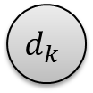

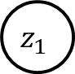
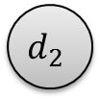





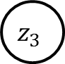
Changes
$$s_{1}$$
$$s_{2}$$
$$s_{3}$$
…
$$s_{n}$$
$$z_{1}$$
$$z_{2}$$
$$z_{3}$$
…
$$z_{n}$$
$$d_{1}$$
$$d_{2}$$
…
$$d_{k}$$
Notes:
OK, so how can we deal more gracefully with missing data?
**************************************
So how can we more gracefully deal with missing data?

Slide 44
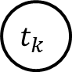
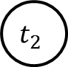
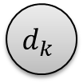
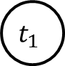


Modeling Missing Data
$$s_{1}$$
$$s_{2}$$
$$s_{3}$$
…
$$s_{n}$$
$$z_{1}$$
$$z_{2}$$
$$z_{3}$$
…
$$z_{n}$$
Mentioned in Text
$$t_{1}$$
$$t_{2}$$
…
$$t_{k}$$
Encourage Agreement
Mentioned in DB
$$d_{1}$$
$$d_{2}$$
…
$$d_{k}$$
Notes:
Our proposed solution is to split these aggregate variables into two parts, one which represents whether each fact is mentioned in the text.
Another which represents whether it is mentioned in the database.
These factors between the two variables just encourage, but don’t require that they agree with eachother.
So now you can see that the facts in FB will act like soft constraints instead of hard constraints as they did previously.
So for example, it’s possible to extract facts not in FB if the local extractors are very confident, but of course we have to pay some penalty for doing that.
********************************************************
We’re proposing to split these aggregate-level variables into two parts.
One which represents whether each fact is mentioned in the text
And another which represents whether it is mentioned in the database.
Then these factors encourage, but don’t require that they agree.
As you can see, the facts in freebase now act like soft rather than hard constraints.
It’s possible to extract facts not in Freebase, if the sentence-level extractors are very confident though you have to pay some penalty for doing it.
******************************************************
And split the aggregate variables into two parts.
-One which is true if a fact is mentioned in the text, and another variable which is true if the fact is mentioned in the database.
-The factors between these two variables encourage, but don’t require agreement; so that it’s possible to violate these constraints, but you have to pay a penalty.

Slide 45
Learning
Old parameter updates:
$\frac{∂{log⁡O}_{i}(θ)}{∂θ}=\max_{p\left(z | s,d;θ\right)}\left(\sum_{j}{f(s_{j},z_{j}) }\right)$ - $\max_{p\left(d,z | s;θ\right)}\left(\sum_{j}{f(s_{j}, z_{j}) }\right)$
Doesn’t make much difference…
New parameter updates (Missing Data Model):
$\frac{∂{log⁡O}_{i}(θ)}{∂θ}=\max_{p\left(t,z | s,d;θ\right)}\left(\sum_{j}{f(s_{j},z_{j}) }\right)$ - $\max_{p\left(t,d,z | s;θ\right)}\left(\sum_{j}{f(s_{j}, z_{j}) }\right)$
This is the difficult part!
soft constraints
No longer weighted edge-cover
Notes:
Learning proceeds in much the same way as before.
Basically the only difference is that we’re also maximizing over these new aggregate hidden variables.
This doesn’t end up making much difference in the unconstrained optimization.
But for the constrained case it makes the inference harder than before (no longer simple bipartite graph matching problem).
******************************************************************
Learning proceeds in much the same way as before, except now we optimize over these additional aggregate level hidden variables.
This doesn’t end up making any difference for the unconstrained inference problem.
It does make the inference problem which is constrained by the freebase facts more difficult.
*********************************************************
The difference here is that we’re also maximizing over these additional hidden variables, but they are deterministically determined by the sentence-level hidden variables, so the real difference is that the Freebase relations act like soft constraints as opposed to hard constraints as before.
*********************************************************
Now we’re optimizing over the t’s in addition to z’s
Effectively this means now we have soft constraints whereas before we had hard constraints.

Slide 46
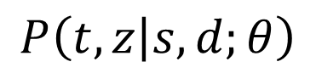
MAP Inference
Aggregate “mentioned in text”
Sentence level hidden variables
Sentences
Database
Find z that maximizes
Optimization with soft constraints
Local search almost always optimal
With carefully chosen search operators
In ~100,000 problems only missed an optimal solution 3 times.
(Compared with optimal solution found using A*)
On problem sizes up to 100 variables (covers most of the data)
$$P\left(t,z | s,d;θ\right)$$
Notes:
OK, so how can we solve this inference problem?
The goal is to find the best assignment to the sentence-level hidden variables conditioned on the observed sentences and database facts.
Remenber that the aggregate “mentioned in text” variables are deterministicly related to the sentence-level relation mention variables.
Like I mentioned this is
************************************************************
****PROBLEM AREA****
The inference problem is to find the best assignment to the hidden sentence-level variables conditioned on the observed sentences and database facts.
Note that the aggregate “mentioned in text” variables are deterministically related to the Z’s
In this case the database facts act as soft constraints, and the inference problem is more difficult than before.
But we find that a simple greedy search almost always finds an optimal solution, so long as we use carefully chosen search operators.
In about 100K problems we only missed an optimal solution in about 3 cases compared against an exact solution found using A*.
**************************************************************8
The inference problem is: given the sentences and the database, predict which facts are actually true, and also which sentences express which relations.
Now we’re saying it’s OK to extract facts not in the database, or not to extract facts contained in the database if the local extractors are very confident, however you have to pay a penalty for this.
This inference problem is more difficult than before, however we found that local search almost always finds an optimal solution, so long as we use a carefully chosen set of search operators.
To verify this we compared against optimal solutions found using A* search (which is much slower and requires much more memory…)

Slide 47
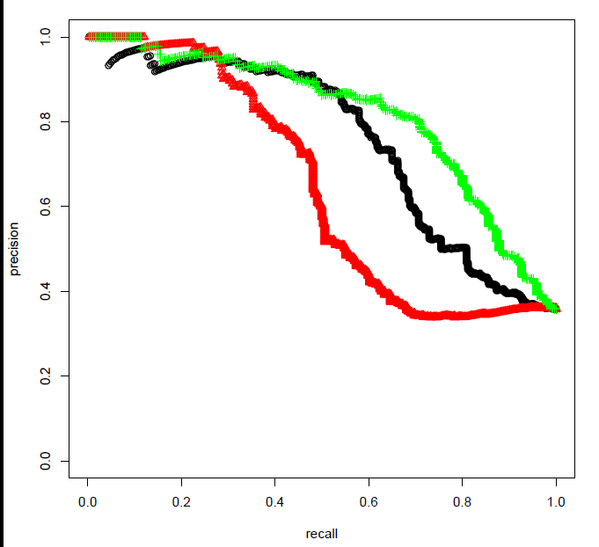
Experiments
Red: MultiR
Black: Soft Constraints
Green: Missing Data Model
[Hoffmann et. al. 2011]
Notes:
OK, so how much difference does explicitly modeling missing data make in practice?
Here I’m showing precision-recall curves on the sentence-level extraction task compared against human judgments.
The red curve is the original system which uses Freebase as hard constraints.
In the black curve we’re using soft constraints with two hand-set parameters, one is the penalty for extracting facts not in FB, the other is the penalty for not extracting facts in FB.
In the green curve we’re incorporating additional information in the form of a missing data model.
By explicitly modeling missing data we’re doing much better. I think we knew these distant supervision models were making some bad assumptions, but I was surprised that there is this much room for improvement.
**********************************************************
-The precision and recall using this approach is much better than the original model
-

Slide 48
Contributions
IE In Informal Text
Analysis of challenges in informal text
Adapted NLP tools to Twitter
http://github.com/aritter/twitter_nlp
Calendar Demo
http://statuscalendar.cs.washington.edu/
Probabilistic Models of Open Domain IE
Unsupervised Event Categorization
Distant Supervision using Topic Models
Modeling missing data in Distant Supervision
Notes:
I’d like to pause for a minute to summarize what I’ve covered so far.
I presented an analysis of challenges in applying NLP and IE to informal text
I talked about our NLP tools we’ve adapted to Twitter.
I showed this demo where we’re extracting a calendar of popular events occurring in the near future.
And finally I presented 3 probabilistic models for open-domain information extraction:
One which automatically discovers an appropriate set of event categories which match the data
A new approach to distant supervision based on topic models which can handle highly ambiguous training data
And an approach to modeling missing data in distant superivion.
*********************************************
TODO: add citations
Unsupervised Event Categorization
Discovers types which match the data
Distant Supervision using Topic Models
Weakly Supervised Named Entity Categorization
Better models for weakly supervised IE
Modeling missing data in distant supervision
OK, so just to summarize, I’ve presented an analysis of challenges involved in adapting NLP tools to noisy text like twitter
I talked about our Twitter-specific tools, which are available for download
I presented a demo of extracting a calendar of popular events which are happening in the near future, which you can check out (linked of my webpage)
I also presented an approach to distant supervision using topic models
I described an approach to unsupervised event categorization which automatically discovers an appropriate set of event types which match the data.

Slide 49


Other Themes
Conversational Modeling in Social Media
[Ritter, Cherry, Dolan, NAACL 2010]
[Ritter, Cherry, Dolan, EMNLP 2011]
Paraphrasing Between Language Styles
[Xu, Ritter, Dolan, Grishman, Cherry, COLING 2012]
[Xu, Ritter, Grishman, In Submission.]
Notes:
Highlight collaborations

Slide 50
Approach: Statistical Machine Translation
[Ritter, Cherry, Dolan, EMNLP 2011]
 | SMT | Response Generation
INPUT: | Foreign Text | User Utterance
OUTPUT | English Text | Response
TRAIN: | Parallel Corpora | Conversations
Notes:
Like I mentioned we’re applying Statistical Machine Translation to this problem.
In SMT the task is given some input foreign sentence to generate an appropriate English response, and in order to learn to do this we use large corpora of paired english and foreign sentences.
**********************************************************
So I mentioned that we’re applying SMT to the response generation task.
In SMT the task is: given an input foreign sentence translate it into english, and in order to learn a model to do this we make use of large corpora of paired foreign/english sentences.

Slide 51
Approach: Statistical Machine Translation
[Ritter, Cherry, Dolan, EMNLP 2011]
 | SMT | Response Generation
INPUT: | Foreign Text | User Utterance
OUTPUT | English Text | Response
TRAIN: | Parallel Corpora | Conversations
Notes:
In response generation, the situation is very similar. Given an arbitrary user utterance our goal is to generate an appropriate response, and in order to do this we’re learning a model from millions of naturally occurring conversations which pair status message with appropriate responses.
************************************************************************
In response generation the situation is very similar. Given an arbitrary user-utterance we want to generate an appropriate response, and to learn a model of response generation we leverage large corpora of naturally occuring conversations which provide observed sentence pairs.

Slide 52
Phrase-Based Translation
STATUS:
[Ritter, Cherry, Dolan, EMNLP 2011]
who wants to come over for dinner tomorrow?
RESPONSE:
Notes:
At a high level how phrase-based translation works is given an input sentence we first segment it into phrases, and then translate each phrase in the input into a phrase in the response.
***************************************************************************
At a high level, how phrase-based translation works is given an input sentence we first segment it into phrases, then translate each phrase in the input into a phrase in the response (potentially with some reordering)

Slide 53
Phrase-Based Translation
STATUS:
[Ritter, Cherry, Dolan, EMNLP 2011]
who wants to come over for dinner tomorrow?
RESPONSE:
Yum ! I
Notes:
-Use Moses phrase-based decoder

Slide 54
Phrase-Based Translation
STATUS:
[Ritter, Cherry, Dolan, EMNLP 2011]
who wants to come over for dinner tomorrow?
RESPONSE:
Yum ! I
want to
Notes:
-Use Moses phrase-based decoder

Slide 55
Phrase-Based Translation
STATUS:
[Ritter, Cherry, Dolan, EMNLP 2011]
who wants to come over for dinner tomorrow?
RESPONSE:
Yum ! I
want to
be there

Slide 56
Phrase-Based Translation
STATUS:
[Ritter, Cherry, Dolan, EMNLP 2011]
who wants to come over for dinner tomorrow?
RESPONSE:
Yum ! I
want to
be there
tomorrow !
Notes:
A good response should consist of good translations at the phrase level, for example we might see “who wants to” translating to “want to”, “come over” translating to “be there”, and tomorrow translation to tomorrow.
In addition a good response should have a high score according to the language model which ensures it is fluent.
*******************************************************************
A good response should consist of good translations, for example we might see “who wants to” triggering “want to” in the response “come over” -> “be there”, and “tomorrow” -> “tomorrow”.
The response should also have a high score according to the language model which ensures it is fluent.

Slide 57
Demo
www.cs.washington.edu/homes/aritter/mt_chat.html
Notes:
More examples, ask for input from audience?

Slide 58
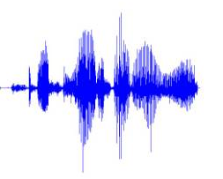
Data Driven Response Generation: Potential Applications
[Ritter, Cherry, Dolan, EMNLP 2011]
Conversationally-aware predictive text entry
Speech Interface to SMS/Twitter (Ju and Paek 2010)
Status:
Response:
Response:
I’m feeling sick
=
Hope you feel better
+
Notes:
The second, and perhaps more immediate application would be to predictive text entry. Assuming a user has just received a message, and is typing a response using some noisy input mechanism, I think we can probably do a better job predicting what they are trying to type by taking the message they’ve received into account. For example if you just received a message from your friend saying “I’m feeling sick”, and you respond to it with a speech signal, well we probably have a good idea of what you would have said based on what you are replying to.
**************************************************
Another potential application is conversationally aware predictive text entry or speech recognition.
Assuming the user is responding to a message, perhaps taking that message into account we can do a better job of predicting what the user is trying to say.
As an example, suppose the user has just received a text message saying “I’m feeling sick”, this should strongly limit the type of response we expect to see, and could help in predicting what the user is trying to say.

Slide 59
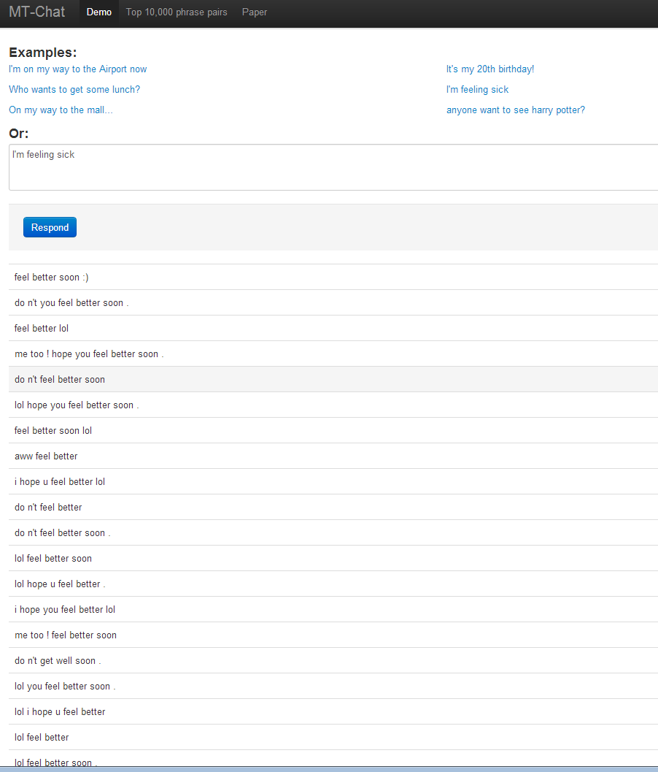

Slide 60
Other Themes
Conversational Modeling in Social Media
[Ritter, Cherry, Dolan, NAACL 2010]
[Ritter, Cherry, Dolan, EMNLP 2011]
Paraphrasing Between Language Styles
[Xu, Ritter, Dolan, Grishman, Cherry, COLING 2012]
[Xu, Ritter, Grishman, In Submission.]
Notes:
Highlight collaborations

Slide 61


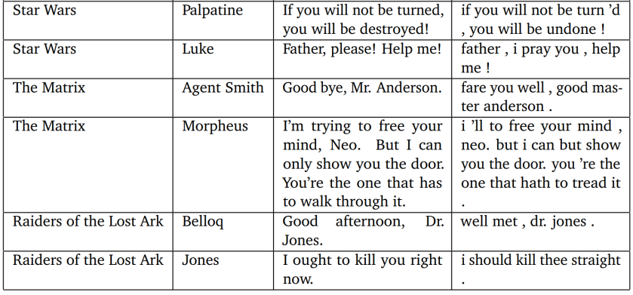
Paraphrasing Language Styles
[Xu, Ritter, Dolan, Grishman, Cherry, COLING 2012]
Approach: use modern translations as parallel text
Father, please! Help me!
--------------------------------
Father, I pray you, help me!
If you will not be turned you will be destroyed!
--------------------------------
If you will not be turn’d, you will be undone!

Slide 62
Paraphrasing Language Styles
[Xu, Ritter, Dolan, Grishman, Cherry, COLING 2012]
Educational Applications
Allow students to access modern English versions
modern translations: Only 17 out of 38 plays
Other Elizabethan authors…
Other Domains
Paraphrasing technical documents
Informal => Formal
Notes:
Translate the other 21

Slide 63
Future Work: Richer Semantics from Microblogs
Clustering Events (Event Reference Resolution)
Group Tweets which refer to the same event
Group Named entities involved in the same event
Schema Discovery
Induce Roles for each type
Classify entities into roles
Concert:
Music Artist
City
Venue
Notes:
One thing is extracting richer semantic representations of events from Microblogs
-Currently our representation for events is still fairly simple, each event is represented by a named entity involved in the event and the date on which it takes place.
-Of course there can be multiple entities involved in an event, or there can be multiple events involving the same entity
-Our current approach has the advantage it is very simple, open-domain and scalable
-Future work: investigate the event reference resolution problem: clustering together all tweets which mention the same event.
Also related that is then schema discovery problem: to discover the entity types which are important for each type of event. For example for a concert event we can expect to see a Music artist, city and venue where the concert takes place
Lots of opportunities for joint inference between clustering events, inducing event types and discovering type schema.

Slide 64

Future Work: Clinical Text Mining
An Analogy:
Notes:
So I’ve argued that we really need automatic text processing techniques to extract and aggregate information from Twitter, because there is a lot of important information there, but it’s very large and unorganized, so no person can read through all of these messages to find all the important information.
I think you can make a similar argument for the informal text that’s generated in clinical environments. There is a lot of high-value information here, but the volume is so large that no person can sift through all of it.
It’s not summarized and organized in a nice way as is the case with text in medical journals.
Again we really need some information extraction techniques to extract structured data from this unstructured text.
PROBLEM AREA
OK, so like I mentioned already, social media often contains more up to date information on a wider variety of topics than news articles.
But the volume of tweets is much larger than news, and they are much more dis-organized, which really motivates the need for NLP and information extraction.
By analogy, many of these arguments apply to clinical text.
It contains more up-to-date information on a wider variety of medical information than medical journals.
There is a lot of important information here which could help lead to new discoveries, for example side effects from untested drug combinations.
But there is also a lot of redundant and irrelevant information for medical researchers in this data.
The information is not neatly organized and summarized, as is the case with articles in medical journals.
We really need NLP and IE to extract and aggregate the most important information.
*****************************************************************
OK, so I’ve made an argument that we have a big opportunity to have impact by applying NLP technology to noisy and unstructured Twitter data.
This is because social media often contains more up-to-date information than news articles on a wider variety of topics.
The amount of social media text is much larger, and it is much less organized than news aritcles.
******************8888888******************************
TODO: How does my work relate to clinical text mining?
In the same way that twitter presents more real-time information on current-events than news articles, I think we can consider clinical text as a more “realtime” source of medical information than medical journals.
In some sense, I think that all the arguments I’ve made for applying information and text mining to Twitter apply equally to informal text generated in clinical environments.
Clinical text is large, unorganized, but contains lots of important information, motivating the need for automatic text processing techniques to extract and aggregate the most important information.

Slide 65
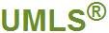

Future Work: Clinical Text Mining
Unsupervised IE
Same techniques should be apply across domains
Unsupervised Event Categorization
Weakly supervised NER
Distant Supervision / Missing Data
Notes:
I’ve talked a lot about unsupervised approaches to information extraction.
One nice thing is that these approaches don’t rely on manually labeled data, so they should easily transfer across domains.
I’ve motivated this work in the context of learning to extract information from Twitter using Freebase as a source of Distant Supervision.
But I think we can easily transfer these techniques to the medical domain simply by replacing tweets with clinical text and Freebase with a more appropriate ontology, for instance the UMLS metathasaurus.
******************************************************
OK, so how might we go about extracting information from this clinical data? I believe many of the kinds of unsupervised approaches to information extraction that I’ve discussed so far, should apply equally well in the clinical domain.
Twitter <=> Freebase Distant Supervision
Clnical text <=> Metathasaurus
***********************************************************
TODO: How does my work relate to clinical text mining?
In the same way that twitter presents more real-time information on current-events than news articles, I think we can consider clinical text as a more “realtime” source of medical information than medical journals.
In some sense, I think that all the arguments I’ve made for applying information and text mining to Twitter apply equally to informal text generated in clinical environments.
Clinical text is large, unorganized, but contains lots of important information, motivating the need for automatic text processing techniques to extract and aggregate the most important information.

Slide 66
Future Work: Medical Research Applications
Identifying patients matching criteria for clinical trials
Much of the information is in text!
Proactively hypothesize treatment problems
Adverse drug interactions
Connecting Genotypes with Phenotypes
Biobanks: Electronic Health Records + genetic information
Much of the information is in text!
Privacy preserving data mining
Automatically mask-out personally identifiable information
Notes:
NEEDS WORK!!!!
*****************************************
I think there are lots of areas where these Information Extraction techniques can have a big impact on medical research.
For instance helping to identify candidates for clinical trials.
Proactively identifying common treatment problems, for example adverse drug interactions. It’s infeasible to run clinical trials for all possible drug combinations, but maybe we can hypothesize some adverse drug interactions by mining large datasets of electronic health records. I believe much of the important information here is likely to be stored in text.
Another area where I think NLP has an opportunity to have an impact is in helping to connect genotypes and phenotypes. People are now starting to collect and mine large biobanks which combine electronic health records with patients genetic information. I believe much of the important phenotype information is likely to be stored in the text.
Finally of course patient privacy is a big concern in all of this. I think NLP has the opportunity to accelerate medical research by automatically masking out personally identifiable information from EHRs. There is simply too much data for a person to go through and manually anonymize .
*********************************************************
PROBLEM AREA
Another area for future work is applying the unsupervised information extraction techniques I’ve developed to other domains.
Because these approaches don’t require annotated data, they should be well suited to other domains, for example biomedical text mining.
For example, unsupervised categorization of biomedical events or weakly supervised entity categorization using the gene ontology and pubmed abstracts.
Furthermore, I’m really interested in applying some of these techniques to more informal styles of text which are generated in the medical domain, for example physician’s notes. I think there is a lot of opportunity for NLP to have impact in this area, for example automatically identifying candidates for clinical trials, or proposing candidate hypothesis from data analysis (e.g. drug interactions – side effects).

Slide 67


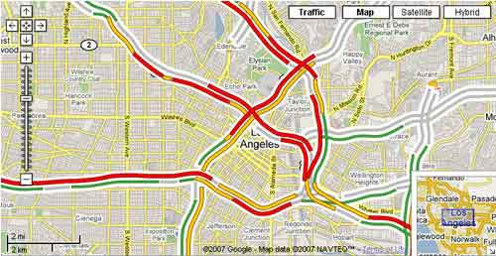

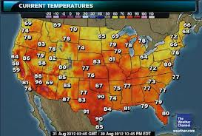

Future Work: Real-World Language Grounding
Notes:
TODO: biobank applications (Kaiser Permanente…)
*****
***** PROBLEM AREA ******
In the longer term I would like to scale up grounded language acquisition to more open-domain real-world datasets.
These days we have access to tons of temporally aligned realtime text and sensor data.
An interesting question is whether we can align events in the text to sensor-data events, for example weather, traffic, or seismic events.

Slide 68
Proposed Approach
Latent Variable Models
Extend to to incorporate realtime text + sensor data
Find links between events text + sensors
Ground the meaning of distributional semantics in real-world sensor data.
Notes:
***** PROBLEM AREA ******
To do this we could think about extending the latent variable models I’ve talked about previously to incorporate sensor data in addition to realtime text, and thereby ground the meaning of these distributional semantics in real-world sensor data at scale.
****************************************************
Can we learn semantics by observing large quantities of naturally occuring time-aligned realtime text, structured and sensor data?
Still want to exploit annotated corpora and progress from half a century of research on NLP, but to model open-domain semantics, really need to exploit large datasets.
Naturally occurring data usually doesn’t correspond to individually annotated sentences -> need to reason about latent variables.

Slide 69

Collaborators
Doug Downey
Oren Etzioni
Emily Fox
Mausam
Stephen Soderland
Luke Zettlemoyer
…
Sumit Basu
Chris Burges
Colin Cherry
Bill Dolan
...
Wei Xu
Ralph Grishman
Thanks!

